Slide 1
Enterprise Risk Management Committee
Jul 21, 2016
Presenter: Alfredo Aguila, CRO
Final/Draft Version: Final

Slide 2
Agenda
0
Last Meeting Minutes
1
Executive Summary and Risk Appetite Statement Update
2
Credit Risk
3
Financial Risk
4
Fiduciary Risk
5
Operational Risk
6
Compliance Risk
7
Policies and Procedures
8
Model Risk Management

Slide 3
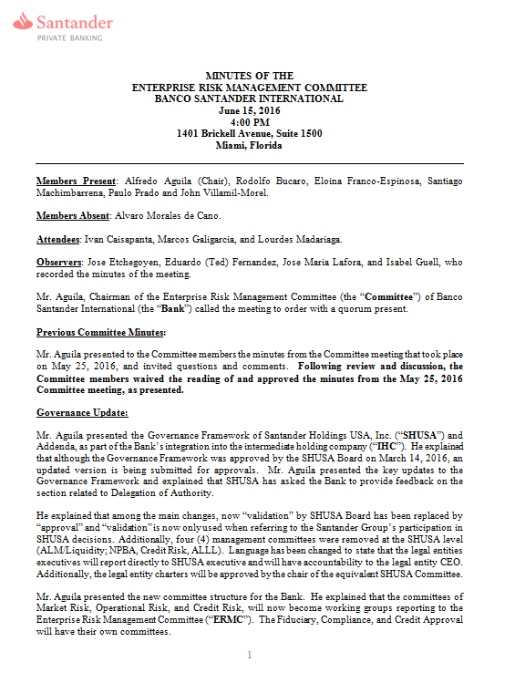
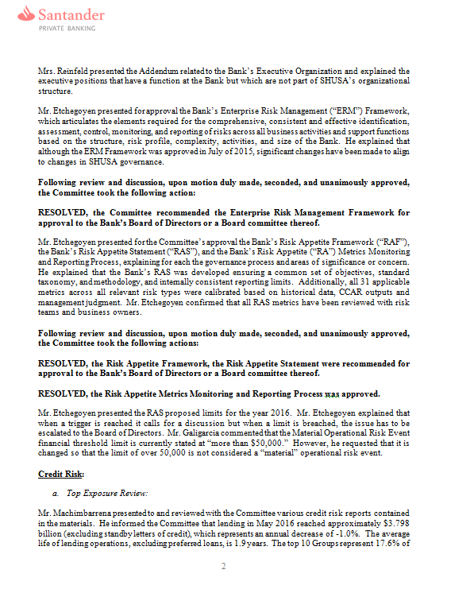

Slide 4
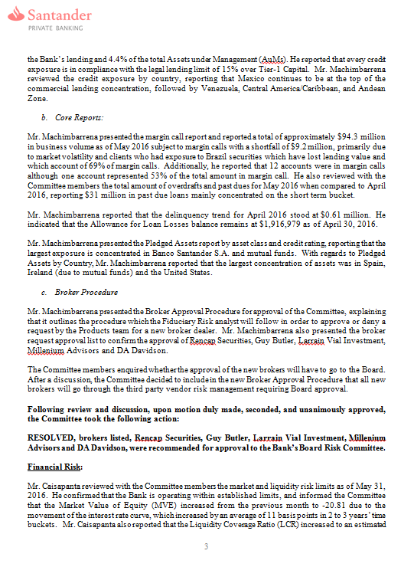
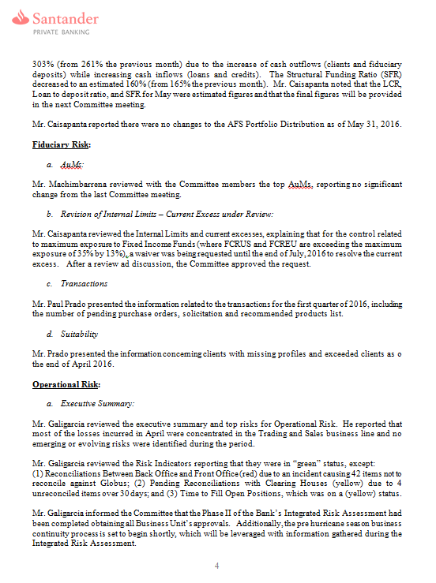

Slide 5
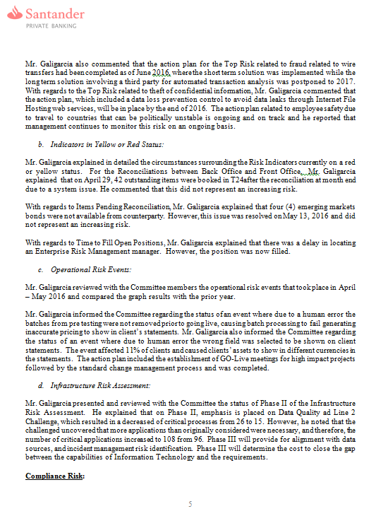
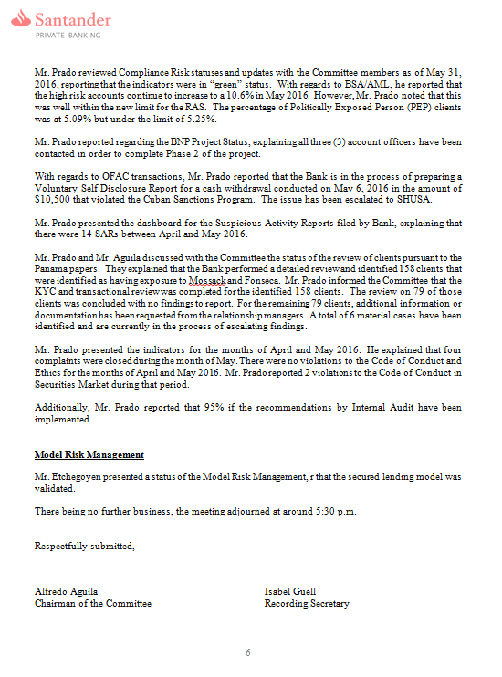

Slide 6
Agenda
Last Meeting Minutes
0
1
Executive Summary and Risk Appetite Statement Update
2
Credit Risk
3
Financial Risk
4
Fiduciary Risk
5
Operational Risk
6
Compliance Risk
7
Policies and Procedures
8
Model Risk Management

Slide 7
1. Executive Summary – CRO Highlights
Key Highlights | Description | Potential Impact | Key Actions | Material Risk reference
Panama Papers Phases I & II status as of: July 8th, 2016 | Performed a detailed review of 178 clients with AUMs of $431MM that were identified as having exposure to Mossack & Fonseca. Focused on completeness of KYC information & documentation, source of wealth and transactions. | Could potentially identify clients who may have been involved in criminal activities. | 139 clients out of the 178 have been concluded with no findings to report. For 39 clients additional information or documentation has been requested from the relationship managers and clients. A total of 6 material cases have been identified and escalated to SHUSA. The cases included two clients where SARs had been previously filed by BSI, 1 case where a SAR was filed as a result of the review and 3 that are currently being investigated. Two of the clients are in process of being de-marketed. Currently reviewing potential matches (>95% probability) as result of scrub of ICIJ list against BSI’s client database. Same due diligence will be performed with confirmed matches. | Regulatory requirements: AML or OFAC
RAS: PEP levels | The RAS has established very restrictive limits for Politically Exposed Persons (PEP) clients over total client base. The limit (5.25%) has already been exceeded since at the end of June 2016 it was 5.40%. | Potential for increase in AML or reputational risk. | Currently reviewing PEP population to initiate project to close low AUM clients and reach RAS levels. In process of defining BSI’s AML Risk Tolerance which may result in the closing of some PEP clients. | Regulatory requirements: AML or OFAC
AML Internal Audit | BSI’s AML Internal Audit report received on June 16. Audit rating downgraded to “Needs Improvement” with four recommendations. | If audit issues are not addressed appropriately, could result in additional regulatory scrutiny. | In process of drafting the Action Plan to address all audit findings. Additional resources will be dedicated to address findings and enhance AML program. | Regulatory requirements: AML or OFAC

Slide 8
1. Executive Summary – Material Risks
T
P
Top Risk
Prioritized Risk
Material Risk | Description | Current Risk Update/RAS and Metrics | Action Plan | Risk Trend | Rem. Status
1. Breach of Fiduciary Duties. Paulo Prado | Improper or inappropriate client investment recommendations or over zealous sales practices including misrepresentations and failure to act in the best interests of the client. | Update: RAS/Metrics: Discretionary Mandates: Aging of Excesses Exceeded Client Investment Profiles (%) | NA |  | N/A
2. Regulatory requirements: AML or OFAC Paulo Prado | Lack of or ineffective processes and controls specific to BSA, AML, or OFAC regulations | Update: RAS/Metrics: High Risk Customers as % of Total Customers Politically Exposed Clients % Total¹ KYC Updates overdue > 90 days AML Transaction Monitoring alerts awaiting clarification > 60 days OFAC Violations OFAC Blocked or rejected transactions | NA |  | N/A
3. Inappropriate /Unsuitable product design Jimena Perez | The Product design is inadequate relative to identified customer need and market factors. | Update: RAS/Metrics: Clients with Missing Profiles (%) Pending Purchase Order Documentation (%) | NA |  | N/A
T
T
Remediation Status:
Complete
On-track
Delayed
At Risk
N/A – Not Applicable
Trend:
Improving
Stable
Worsening

Slide 9
2. Risk Appetite Statement Dashboard
Risk Type |  | Status |  | RAS Metric Summary |  | Qualitative assessment |  | Key Breach Actions
1. Capital adequacy |  |  |  | All metrics are amply in the green zone. |  | Capital levels are well in excess of regulatory requirements |  | Not Applicable
2. Credit risk |  |  |  | All metrics are amply in the green zone. |  | Credit Risk is very limited due to the Secured Lending Model. Exceptions and concentration metrics are well below triggers/limits |  | Not Applicable
4. Liquidity / Funding risk |  |  |  | All metrics are amply in the green zone. |  | Liquidity levels are well in excess of regulatory requirements |  | Not Applicable
5. Interest rate risk |  |  |  | All metrics are amply in the green zone. |  | Interest Rate and NIM Sensitivity levels are well in excess of regulatory requirements |  | Not Applicable
7. Operational risk |  |  |  | All metrics are amply in the green zone. |  | Operational Risk metrics are adequate to BSI risk profile. As data on additional risk types is available (ie: Legal losses) metric adjustments may be needed. |  | Not Applicable
Fiduciary Risk |  |  |  | All metrics are amply in the green zone. |  | Fiduciary risk levels are well in excess of market practice and regulatory requirements |  | Not Applicable
8. Model risk |  |  |  | All metrics are amply in the green zone. |  | Models are validated according to schedule. |  | Not Applicable
9. Compliance and Reputational risk |  |  |  | Three metrics are in amber as they have started at these levels. OFAC blocked/rejected transactions; PEPs % Total Clients AML Transaction Monitoring alerts awaiting clarification > 60 days |  | OFAC blocks and rejects are handled following industry practices and they are escalated to several Governance bodies: Compliance Committee, ERMC and BRC. PEPs are part of BSI target market and the ratio of PEPs % total customers is stable at 5% +/- 50 bps monthly variations ASSIST alerts pending greater than 60 days above the RAS trigger due to man hours devoted to the BSA/AML/OFAC Internal Audit |  | Initiated project to close PEPs with low balances to reduce risk and bring RAS below trigger. Staff addressing current clarifications, metric will be below trigger by month end.
Aggregated RAS status for the purpose of this summary is based on expert judgment and reviewed by ERMC prior to RC and Board.
Strategic Risk, spanning every risk category, is managed through strategic planning, material risk program, and new products/business activities. For RAS purposes, it will be represented by: 1) qualitative statements for strategic risk that we currently use, and 2) monitored through all RAS metrics being presented in each risk category.
Focus of Concern
Area of attention
Not a concern

Slide 10
3. 2016 BSI RAS – Limits (1/3)
* SHUSA metric reported in Santander Group RAS
 |  |  | Baseline scenario |  |  |  | BHC Stress scenario
Risk type | Ratio | Frequency | Jun 16 | Base | Amber trigger | Red limit | BHC Stress | Amber trigger | Red limit
Capital adequacy (ratios) | *Common Equity Tier 1 | Monthly | 83.89% | 78.86% | <=18.60% | <=16.60% | 80.17% | <=13.60% | <=11.60%
 | *Total Risk-based Capital | Monthly | 87.65% | 82.43% | <=20.10% | <=18.10% | 83.74% | <=19.35% | <=17.35%
 | *Tier 1 Leverage | Monthly | 13.26% | 13.48% | <=10.75% | <=8.75% | 13.67% | <=9.75% | <=7.75%
 | *Tier 1 Risk-based Capital | Monthly | 83.89% | 78.86% | <=24.35% | <=22.35% | 80.17% | <=15.10% | <=13.10%
See Metric glossary in appendix for metric definitions

Slide 11
3. 2016 BSI RAS – Limits (2/3)
* SHUSA metric reported in Santander Group RAS
Risk type | Metric | Frequency | Portfolio | Jun 16 | Amber trigger | Red limit
Capital adequacy (other) | Impairment to Pre-Provision Net Revenue (PPNR) | Annual (9Q CCAR 2016) | BSI Miami | $42M | >=$52M | >=$58M
Credit risk | *Secured Lending Value Exceptions (%) | Quarterly | BSI Miami | 0.61% | >=1.5% | >=2%
 | Individual Obligor Exposure | Quarterly | BSI Miami | 9.96% | >=12% | >=15%
 | Top 10 Obligors Exposure | Quarterly | BSI Miami | 53.5% | >=75% | >=90%
Liquidity / funding risk | *Stressed Survival Period (days) | Monthly | BSI Miami | >90 | <= 75 days | <= 45 days
 | *Liquidity Coverage Ratio (US) | Monthly | BSI Miami | TBD | <= 110% | <= 100%
 | *Structural Funding Ratio (%) | Monthly | BSI Miami | 162% | <=121% | <=100%
Interest rate risk | *NII¹ Sensitivity(+/- 100bps) | Monthly | BSI Miami | -8.55 | <=-21% | <=-27%
 | *MVE² Sensitivity(+/- 100bps) | Monthly | BSI Miami | -12.94 | <=-3% | <=-4%
Operational risk | *Gross Operational Risk Losses / Gross Margin | Quarterly (trailing 12m) | BSI Miami | 0.16% | >=1.25% | >=2%
 | Material Operational Risk Events (financial threshold >50K) | Quarterly | BSI Miami | 0 | >=3 | >=5
Model risk | Legacy Tier 1 Models not submitted for validation | Monthly | BSI Miami | 0 | 2016 - 2 2017 – 0 | 2016 - 3 2017 – 0
See Metric Glossary in appendix for metric definitions
NII: Net Interest Income
MVE: Market Value of Equity

Slide 12
3. 2016 BSI RAS – Limits (3/3)
Risk type | Metric | Frequency | Portfolio | Jun 16 | Amber trigger | Red limit
Compliance & Reputational risk | Open MRIAs and other alike matters requiring immediate attention | Monthly | BSI Miami | 0 | N/A | >0
 | Total Customer Complaints Received (YTD) | Monthly | BSI Miami | 10 | >=25 | >=35
 | Past Due Compliance Monitoring CAPS | Monthly | BSI Miami | 0 | N/A | >0
 | Violations of Code of Conduct and Ethics | Monthly | BSI Miami | 0 | >0 violation warnings | >0 repeat violations
 | High Risk Customers as % of Total Customers | Monthly | BSI Miami | 10.80% | >=13% | >=15%
 | Politically Exposed Clients % Total¹ | Monthly | BSI Miami | 5.40% | >=5.20% | >=5.25%
 | KYC Updates overdue > 90 days | Monthly | BSI Miami | 1.70% | >=2% | >=3%
 | AML Transaction Monitoring alerts awaiting clarification > 60 days | Monthly | BSI Miami | 25 | >=20 | >=30
 | OFAC Violations | Quarterly | BSI Miami | 0 | N/A | >0
 | OFAC Blocked or rejected transactions | Quarterly | BSI Miami | 1 | >=1 | >=2
Fiduciary risk | Clients with Missing Profiles (%) | Monthly | BSI Miami | 1.8% | >=6% | >=8%
 | Exceeded Client Investment Profiles (%) | Monthly^{2,3} | BSI Miami | 13.3% | >=16% | >=20%
 | Pending Purchase Order Documentation (%) | Monthly | BSI Miami | 5.0% | >=10% | >=13%
 | Discretionary Mandates: Aging of Excesses (days) | Monthly | BSI Miami | < 60 days | >=60 days | >=90 days
 | Regulation R Bank-wide “chiefly-compensated” test | Annual⁴ | BSI Miami | 76% | <=74% | <=72%
¹ Under review pending segmentation of PEPs to quantify highest risk PEPs. Will recommend new limit by next Board meeting.
See Metric Glossary in appendix for metric definitions
2 REQ: Level of Equivalent Risk
^{3 EM: Emerging Markets}
4 Annual metrics reported as of Dec ’15

Slide 13

13
BSI Trigger / limit breach description and Action Plan
Risk Type | Metric | Mar-16 | Apr-16 | May-16 | Jun-16 | Red | Amber | Remediation Status
Compliance & Reputational | Politically Exposed Clients % Total | 5.09% | 5.16% | 5.30% | 5.40% | 5.25% | 5.20%
Historical Trend (12m):
Trigger/Limit Breach Description:
PEP clients increased and the total number of clients decreased during the same period: during the months of May and June, a reclassification of current customers increased the number of total PEPs. At the same time, the total number of clients at BSI decreased. As a result, the percentage of PEPs to total clients increased.
Action Plan:
Initiated project to close PEPs with low balances to reduce risk and bring metric below RAS trigger.
Closely monitoring at ERMC, RC, and Board.
Issues Identified in the Action Plan:
Low tolerance recently defined. Closing clients requires a careful evaluation of the impact and the specific situation of each client individually and, in some cases, as part of a group (“Decision Unit”).
Remediation Status:
Complete
On-track
Delayed
At Risk
N/A
Trend:
Improving
Stable
Worsening
Notes:
13
13

Slide 14
14
BSI Trigger / limit breach description and Action Plan
Risk Type | Metric | Dec-15 | Feb-16 | Apr-16 | Jun-16 | Red | Amber | Remediation Status
Compliance & Reputational | AML Transaction Monitoring alerts awaiting clarification > 60 days | 13 | 13 | 13 | 25 | 30 | 20
Historical Trend (12m):
Trigger/Limit Breach Description:
ASSIST alerts pending greater than 60 days are above the RAS trigger due to man hours devoted to the BSA/AML/OFAC Internal Audit as well as the 2016 FED Safety and Soundness examination during the quarter.
Action Plan:
Staff addressing current clarifications, metric will be below trigger by month end.
Closely monitoring at ERMC, RC, and Board.
Issues Identified in the Action Plan:
No issues identified to return to values within the acceptance range
Remediation Status:
Complete
On-track
Delayed
At Risk
N/A
Trend:
Improving
Stable
Worsening
Notes:
14
14

Slide 15
Agenda
0
Last Meeting Minutes
1
Executive Summary and Risk Appetite Statement Update
2
Credit Risk
3
Financial Risk
4
Fiduciary Risk
5
Operational Risk
6
Compliance Risk
7
Policies and Procedures
8
Model Risk Management

Slide 16
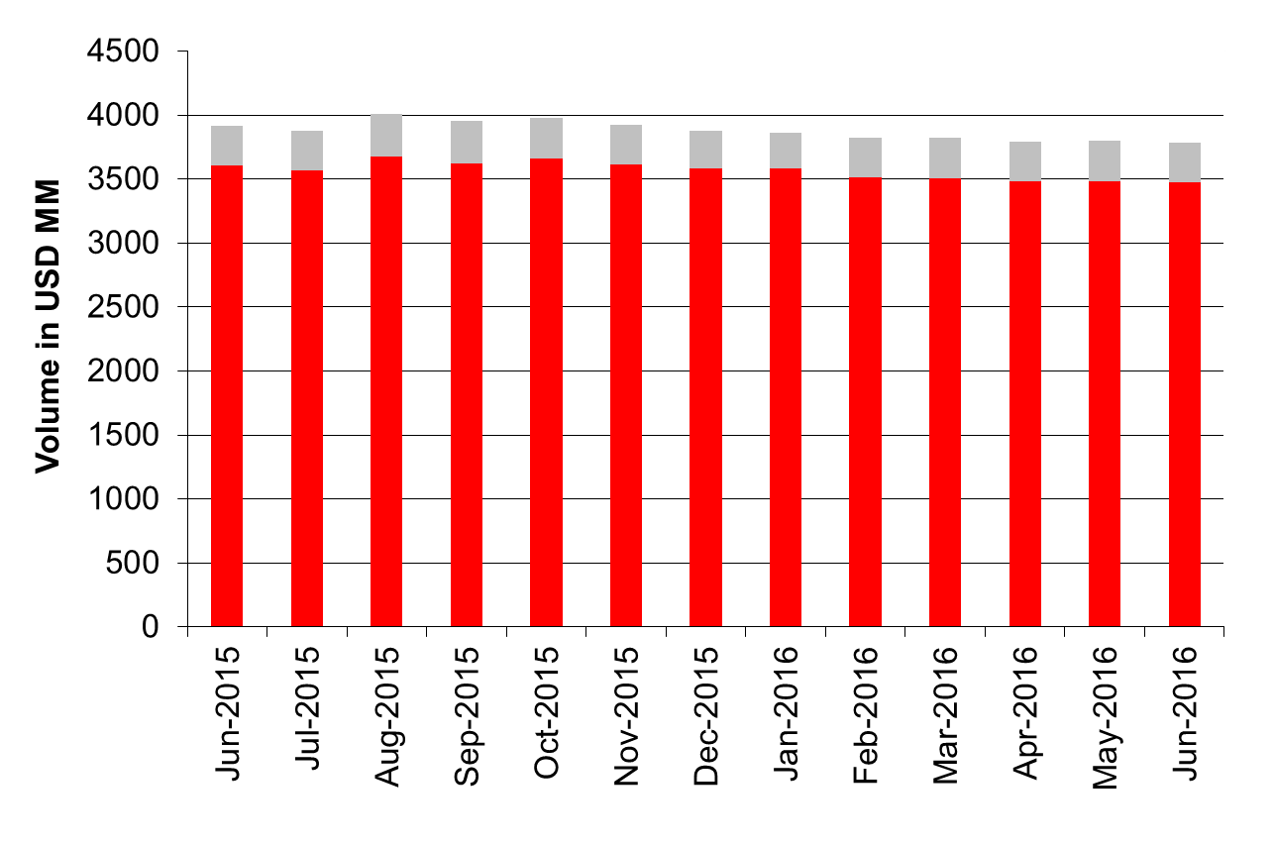
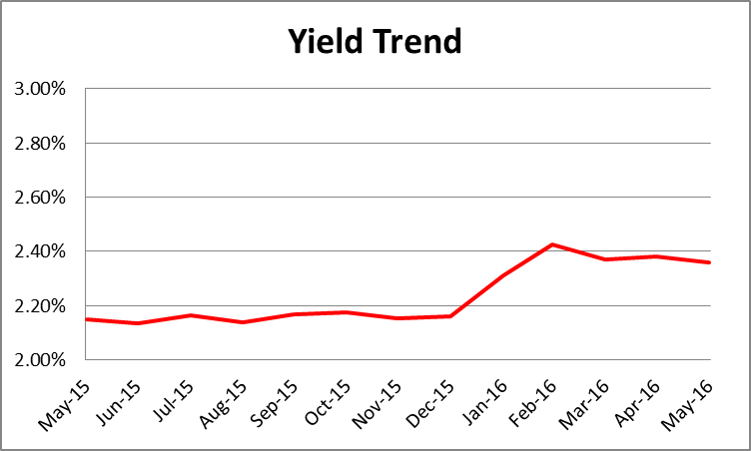
Credit Exposure Miami
Lending in June is USD 3,781 MM (4,203 operations) which represents an annual decrease of -3.6% in loans (excluding SB/LCs).
Yield was stable during 2015, and has increased in 2016.
The average life of lending operations, excluding preferred loans, is 1.1 years.
Lending Trend (12 months)
3.5%
Lending
$3,781m
Pledged
$7,552m
LTV Ratio
50.1%

Slide 17
Credit Exposure SPB Miami
Top 10 Groups account for 13.4% of lending and 4.2% of total AuM’s
Every credit exposure is in compliance with Legal Lending Limit of 15% over Tier-1 Capital
By Commercial Area, lending is concentrated in Mexico, Venezuela, Andean Zone, and Central America/ Caribbean with 77.1% of total loans.
Region 1 tops with 41% of lending
TOP 10 Credit Exposures
Credit Exposure by Geographic Zones

Slide 18
Pledged Assets
By Asset Class
By Rating (Top 25)

Slide 19
Pledged Assets by Country
Santander Break Down
By Rating (Top 25)

Slide 20
Assets under Management
By Asset Class
By Rating (Top 25)

Slide 21
Assets under Management by Country
Santander Break Down by Country
By Rating (Top 25)

Slide 22
Margin Call Report - Miami
Volume subject to margin was USD 18 MM and shortfall USD 1.4 MM. Considering these figures are one week after the Brexit volatility, the amount is very low.
All customers have been contacted by margin call letter or banker and have an action plan in place to solve the Margin Calls. Regular follow up is performed.

Slide 23
Margin Call Report - BSI
Valuation
Margin Call
Margin Calls
Credit
MTM
LTV
Shortfall
Under Water
Business as usual
June
17,951,431
21,456,732
16,509,013
-1,442,418
0
May
94,396,717
153,781,336
85,184,458
-9,212,259
0
April
93,275,548
192,180,082
78,209,565
-15,965,083
0
SUS/Créditos
105,559,367
106,388,303
84,501,833
-21,057,534
-3,268,913

Slide 24
Overdraft & Past Dues

Slide 25
Delinquency Trend (04/2004 BDE)

Slide 26
Allowance for Loan Losses

Slide 27
Agenda
0
Last Meeting Minutes
1
Executive Summary and Risk Appetite Statement Update
2
Credit Risk
3
Financial Risk
4
Fiduciary Risk
5
Operational Risk
6
Compliance Risk
7
Policies and Procedures
8
Model Risk Management

Slide 28
Market & Liquidity Risk Limits
Financial Risk Limits

Slide 29
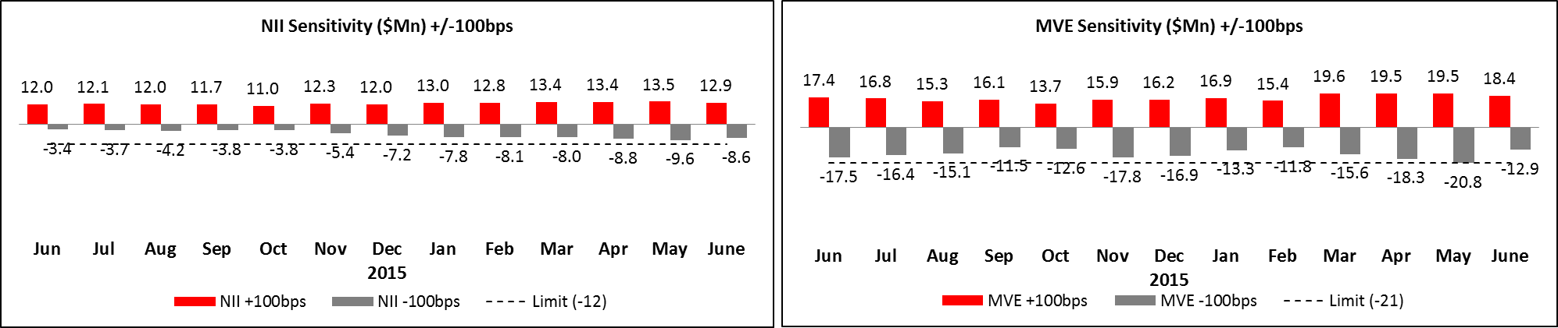
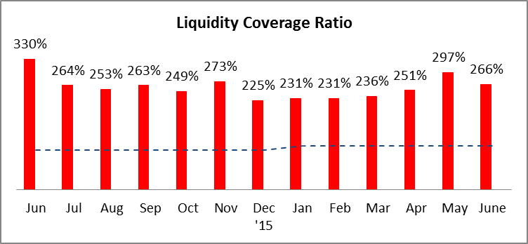
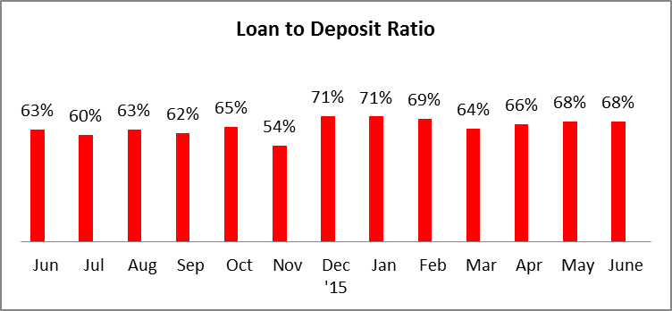
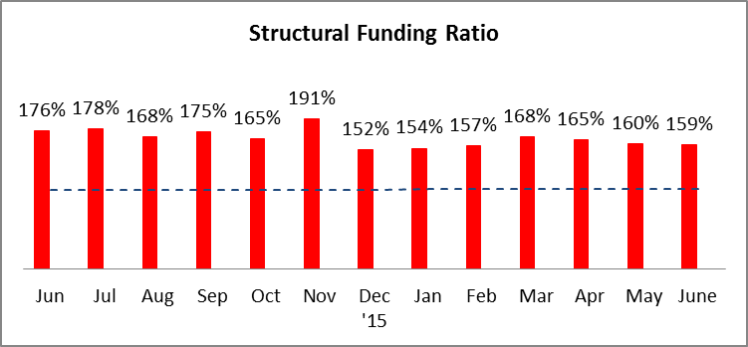
Market and Liquidity Risk-Trends/Comments
NII and MVE Sensitivity
under -100bsp decrease:
NII: -1.08MN.
MVE: -7.87MN.
This reduction was due to the movement of the interest rate curve which decreased in average for our top 4 currencies 23bsp.
Liquidity Coverage Ratio decreased from 303% to 266% due to a decrease of Liquid Assets (Central Bank Balance) and Cash inflows (Loans and credits).
Note: Liquidity Coverage Ratio for June was calculated with estimated figures.

Slide 30
AFS – Portfolio Distribution
No positions in ALCO portfolio by June-end
AFS –REPOSSESSED COLLATERAL

Slide 31
Agenda
0
Last Meeting Minutes
1
Executive Summary and Risk Appetite Statement Update
2
Credit Risk
3
Financial Risk
4
Fiduciary Risk
5
Operational Risk
6
Compliance Risk
7
Policies and Procedures
8
Model Risk Management

Slide 32
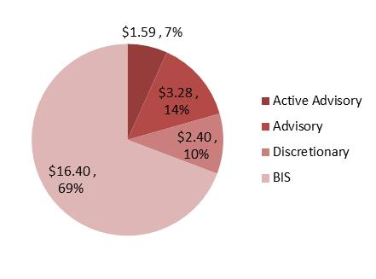
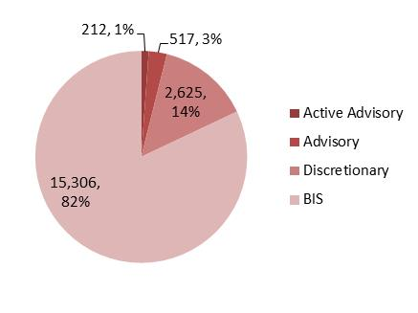
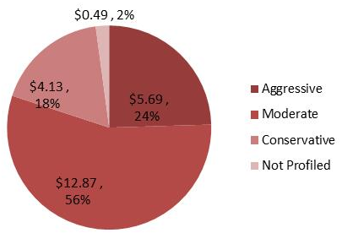
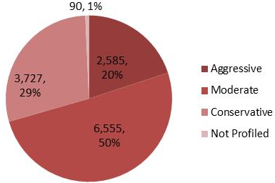
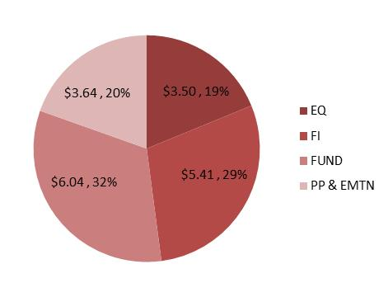
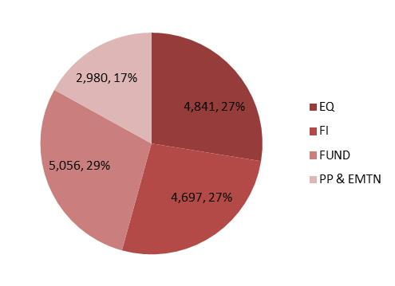
Fiduciary Risk
Overview
Transactions
Suitability
AuM in US$ bn.
Number of Clients
by Investment Platform
by Investment Profile
by Asset Type
*PP & EMTN: Private Placement & European Medium Term Notes

Slide 33
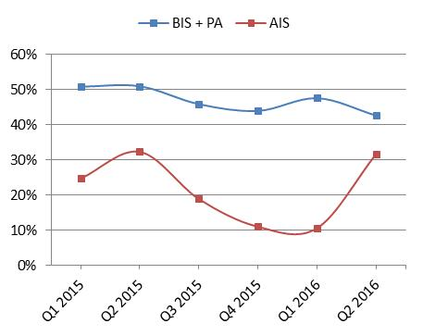
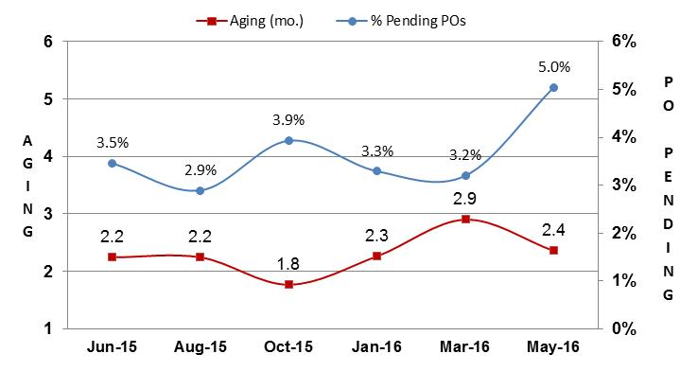
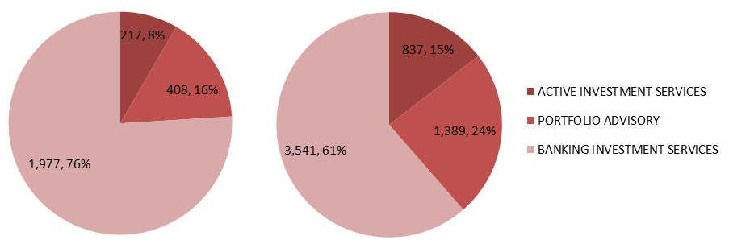
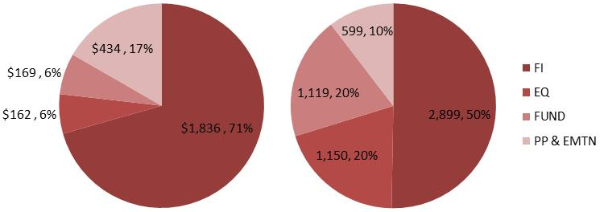
Fiduciary Risk
Overview
Transactions
Suitability
Pending Purchase Orders
Solicitation
18-month data POs pending
Transactions 2nd Q 2016
in MM
Transactions
in $ MM
Transactions

Slide 34
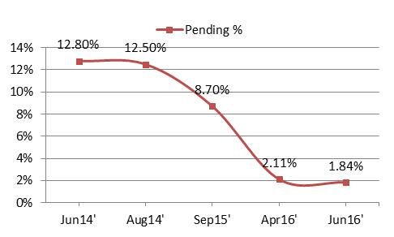
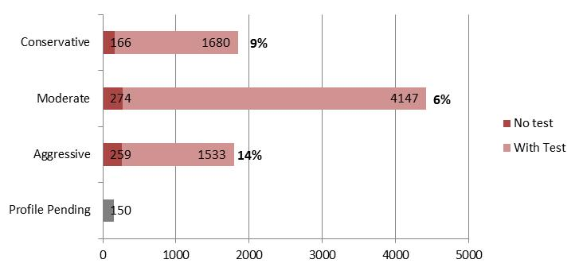
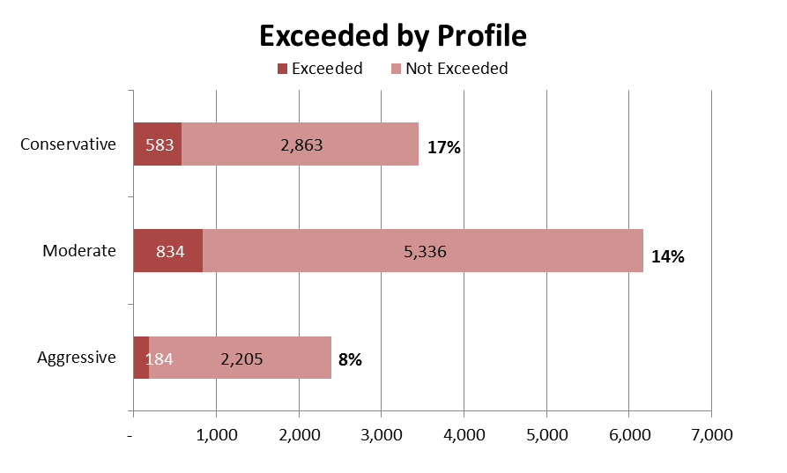
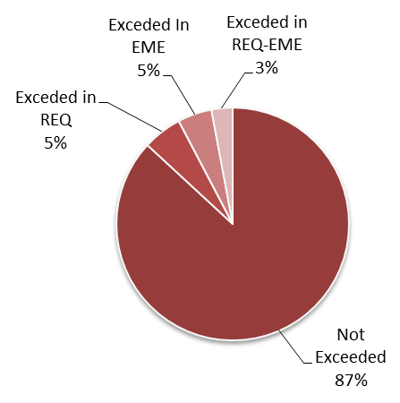
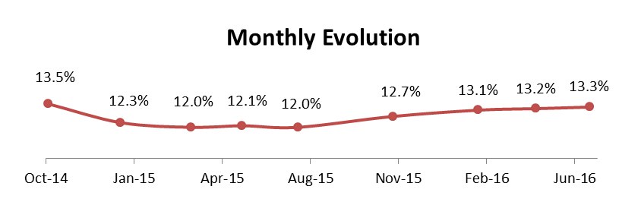
Fiduciary Risk
Transactions
Suitability
Clients with Missing Profiles
Clients Exceeded REQ & Emerging

Slide 35
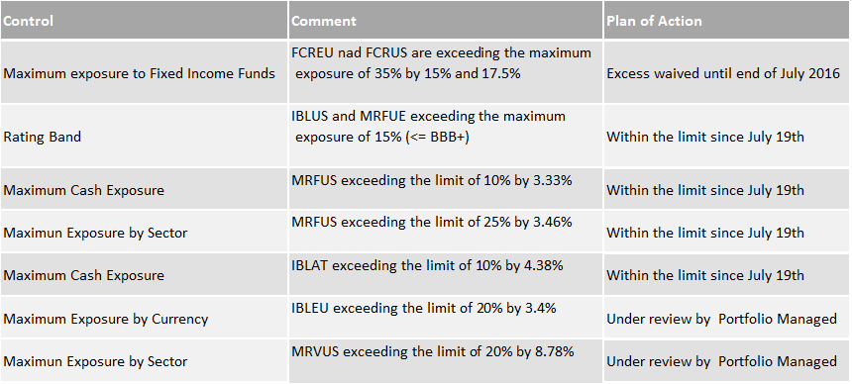
Discretionary Models limits
Current Excesses' Under Review

Slide 36
Agenda
0
Last Meeting Minutes
1
Executive Summary, Highlights & Risk Appetite Statement Update
2
Credit Risk
3
Financial Risk
4
Fiduciary Risk
5
Operational Risk
6
Compliance Risk
7
Policies and Procedures
8
Model Risk Management

Slide 37
Operational Risk
Executive Summary
All Operational Risk Appetite metrics are in green status.
Most losses are concentrated in the Trading and Sales business line.
FED examination preliminary soft closing included a comment about better documenting event escalation procedures. An escalation procedure has been drafted and will be implemented shortly.
BSI is participating in a US level review of wire transfer processes initiated by SHUSA.
OFAC screening issue was escalated to SHUSA
Top Risks
Risks | Action Plans | Due Date | Status
Fraud related to wire transfers | Analyze risk weighting of individual transactions using multiple factors. Short term action - Wire requests matching specific criteria will generate an alert to the front office for Call Back requirement (PIN and Test Key clients included) Long term action - Automated transaction analysis was postponed to 2017 | Jun 2016 | n
Theft of Confidential Information | Implement Data Loss Prevention control to avoid data leaks through Internet File Hosting web services. | Dec 2016 | n
Employee safety due to travel to countries that can be politically unstable | Management monitors this risk on an ongoing basis. | Ongoing | n
STATUS: n Completed; n On Track; n Needs Attention; n At Risk; n On Hold

Slide 38
Program Updates / Key Activities
Operational Risk Management | Event Escalation Procedure has been drafted to comply with FED comment. Active participation for HERACLES – Action Drivers and Reporting modules BSI participation on the IV Operational Risk Forum driven by Madrid.
Third Party Risk Management | Due Diligence reports of BSI critical and high risk third parties have been shared and discussed with the Business Owners for findings and are pending final sign-off. Phase 2 of the annual Due-Diligence exercise for BSI moderate risk third parties will be kicked off during the month of July. Several new third parties or engagements are being reviewed as a part of TPRM process. Internal Audit is conducting an Audit for BSI Third Party Management program for the first time.
Business Continuity Management | The following tests have been completed Mass notification call tree DR testing for critical applications Loss of Facility Incident Management Team training conducted with follow-up trainings now scheduled BC in the Cloud reporting enhancements to allow for Line 2 challenge significantly progressed, with more enhancements planned.
Information Risk Management | No significant updates to report.

Slide 39
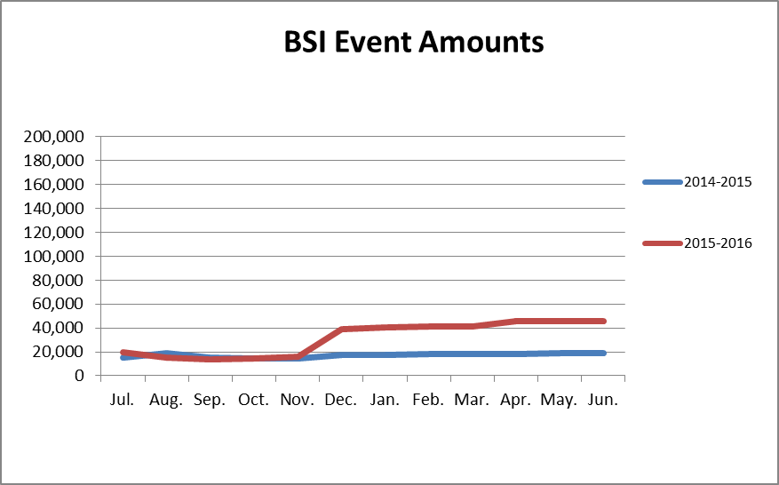
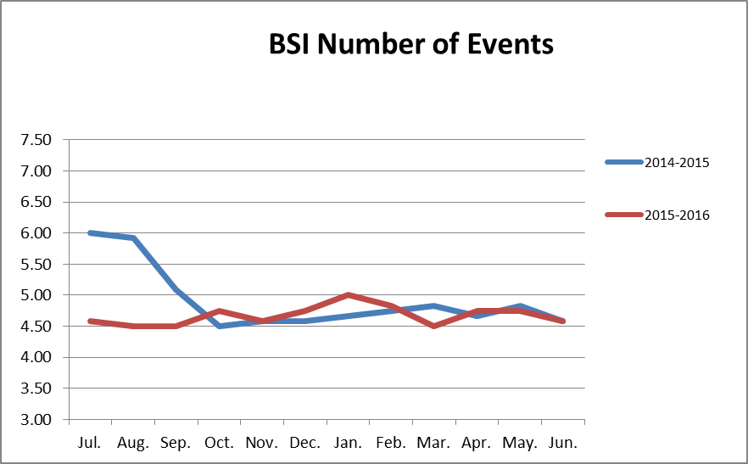
Operational Risk Metrics
Rolling Average of yearly Operational Risk Events & Losses compared to previous year *
* Based on ocurrence date
Notes:
Implemented audit recommendation 06/30/14
The trade execution process will be modified such that Back Office Securities does not participate in the pre-execution trade validation process. Documented procedures will adequately reflect the modified process.
Implemented audit recommendation 05/31/14
Automated reconciliation processes surrounding 360, T24, and Bloomberg will be improved to include unexecuted orders:
• Placed in 360 but not reflected in T24
• Placed in T24 but not reflected in Bloomberg
• Placed in Bloomberg but not reflected in T24
2015:
Dec 2015 - $292,773 - Duplicated payments due to reprocessing of a batch file which was not removed from the server (Recovered $279,430)
Jul 2015 - $19,032 - Input error. Overpurchase of shares. (Trading Process -AIS)
Jun 2015 - $24,900 - Order was requested to by GTC and was placed as GTD (Trading Process -AIS)
Apr 2015 - $33,025 - Fraudulent instructions processed to an unauthorized beneficiary since 2007 (Wire Payment)
Jan 2015 – $17,085 - Fraudulent wire transfer instructions processed. (Wire Payment)
Recoveries:
$4,544 - Related to fraudulent wire transfer from Dec 2014
2014:
31 Dec 2014 - $33,237.41 - Advisor introduced cash value as nominal on 360.
28 Aug 2014 - $52,900.00 -Trading script was not followed, consequently overpurchase of shares due to a not updated price.
24 Apr 2014 - $24,529.19 - BSI was not informed on changes in BoA credit line. Therefore IRS payment was rejected.
Recoveries:
No recoveries in YTD. 2013:
30 Sep 2013 - $51,234.67 - Trading error with Managed Accounts. Modeling was run with incorrect security price.
Recoveries:
Debit Card Fraud: $5,906.31 on 2013 from 4 events.
Non-client counterparty and financial institution disputes. Facebook IPO: $23,282.31

Slide 40
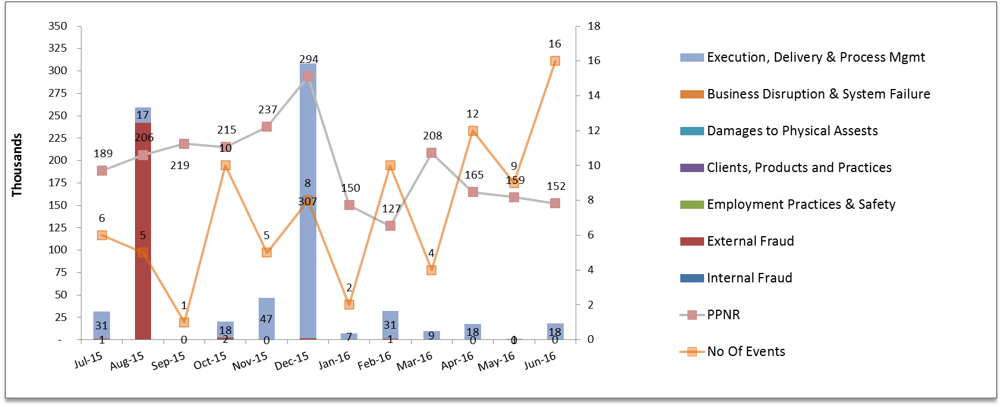
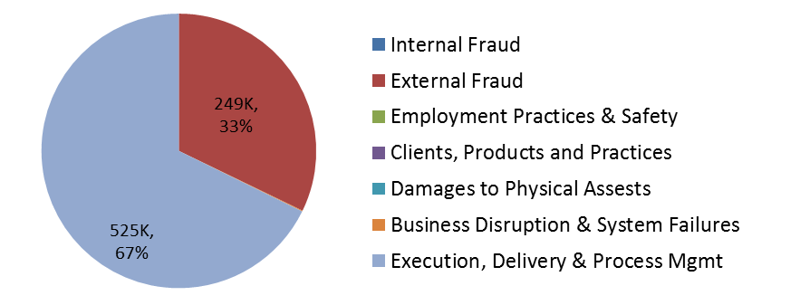
Operational Risk Metrics
Gross Losses against Pre Provision Net Revenue (PPNR) Tolerance Limit
Duplicated wire payments event (292k).
All funds were recovered with no impact to BSI by May, 2016.
Mitigating actions include:
Reinforced manual controls
Project to improve documentation and controls around interfaces (October 2016)
Implementation of Fedlink Direct Connect (November, 2016)
Last 12 months Gross Losses: $784K

Slide 41
Operational Risk – Wires Screening Event
Wires that had been screened for OFAC were marked as “OFAC not Processed” and subsequently released.
On June 27th 2016, the Operations team identified a potential issue with some messages that were able to be approved in the OFAC screening application although the status was “OFAC not Processed”. The OFAC Server vendor was immediately contacted in order to investigate the reason for this inconsistency. The vendor concluded that although the wires were scanned and had no hits, due to a timeout interruption of the process, the OFAC application could incorrectly set the status to “OFAC not Processed”. Subsequently the application would allow approving the transaction.
Root Cause
Bug in the software package used for OFAC screening introduced to BSI during an upgrade on May 14, 2016.
Mitigating Actions
Two corrections to the OFAC application were applied on July 1st in order to 1) not produce this status incorrectly, and 2) not allow approving messages with “OFAC not Processed” status.
Management has received evidence from the vendor to substantiate that all 86 affected wires (29 incoming and 57 outgoing since the date of the upgrade) were screened for OFAC.
Management is currently analyzing other systems in order to replace the current system with a better tool.
Notes:
Implemented audit recommendation 06/30/14
The trade execution process will be modified such that Back Office Securities does not participate in the pre-execution trade validation process. Documented procedures will adequately reflect the modified process.
Implemented audit recommendation 05/31/14
Automated reconciliation processes surrounding 360, T24, and Bloomberg will be improved to include unexecuted orders:
• Placed in 360 but not reflected in T24
• Placed in T24 but not reflected in Bloomberg
• Placed in Bloomberg but not reflected in T24
2015:
Dec 2015 - $292,773 - Duplicated payments due to reprocessing of a batch file which was not removed from the server (Recovered $279,430)
Jul 2015 - $19,032 - Input error. Overpurchase of shares. (Trading Process -AIS)
Jun 2015 - $24,900 - Order was requested to by GTC and was placed as GTD (Trading Process -AIS)
Apr 2015 - $33,025 - Fraudulent instructions processed to an unauthorized beneficiary since 2007 (Wire Payment)
Jan 2015 – $17,085 - Fraudulent wire transfer instructions processed. (Wire Payment)
Recoveries:
$4,544 - Related to fraudulent wire transfer from Dec 2014
2014:
31 Dec 2014 - $33,237.41 - Advisor introduced cash value as nominal on 360.
28 Aug 2014 - $52,900.00 -Trading script was not followed, consequently overpurchase of shares due to a not updated price.
24 Apr 2014 - $24,529.19 - BSI was not informed on changes in BoA credit line. Therefore IRS payment was rejected.
Recoveries:
No recoveries in YTD. 2013:
30 Sep 2013 - $51,234.67 - Trading error with Managed Accounts. Modeling was run with incorrect security price.
Recoveries:
Debit Card Fraud: $5,906.31 on 2013 from 4 events.
Non-client counterparty and financial institution disputes. Facebook IPO: $23,282.31

Slide 42
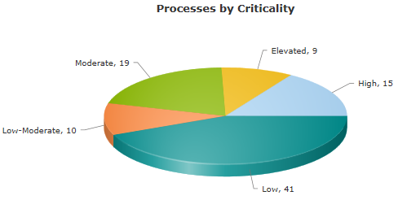
Phase II Executive Summary
Phase II Highlights
Next Steps (Phase III)
Metrics
Emphasis placed on Data Quality and Line 2 Challenge resulted in a decrease of Critical Processes of 1/3.
First Entity on boarded to “BC in the Cloud”. SHUSA provided support implemented 38 change requests.
Closure of a 2015 MRIA related to Business Continuity.
Alignment with Application Portfolio Management
Alignment with Data Sources (i.e. HR, Facilities, IT)
Incident Management
Risk Identification
2017 Risk Remediation Funding
Management approval *as needed
Tool alignments
Phase I
(Jan)
Phase II
(Jun)
2016
BIAs Conducted
31
32
Total # of Process Identified
94
94
# of Critical (High) Processes
26
25
Total # of Applications
96
108
# of Critical Applications
10
32
# of Critical Employees
NA
31
Previously reported as 15
Updated

Slide 43
# of Critical Employees
Critical Employees
Index
Total # of Staff supporting a “Critical Process”
91
# Requiring Hot Site Seating
26
Minimum # Needed
31
Named Critical Employees
31
2016
July
IMT Members (+ Support Group)
14
# of BCCs
32

Slide 44
Agenda
0
Last Meeting Minutes
1
Executive Summary, Highlights & Risk Appetite Statement Update
2
Credit Risk
3
Financial Risk
4
Fiduciary Risk
5
Operational Risk
6
Compliance Risk
7
Policies and Procedures
8
Model Risk Management

Slide 45
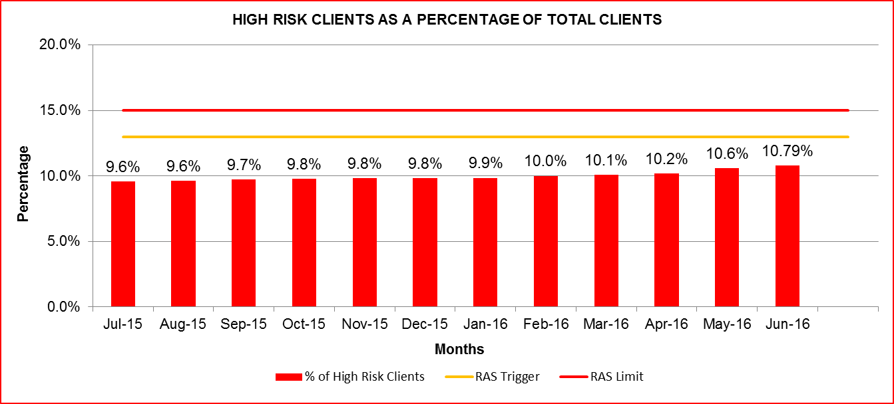
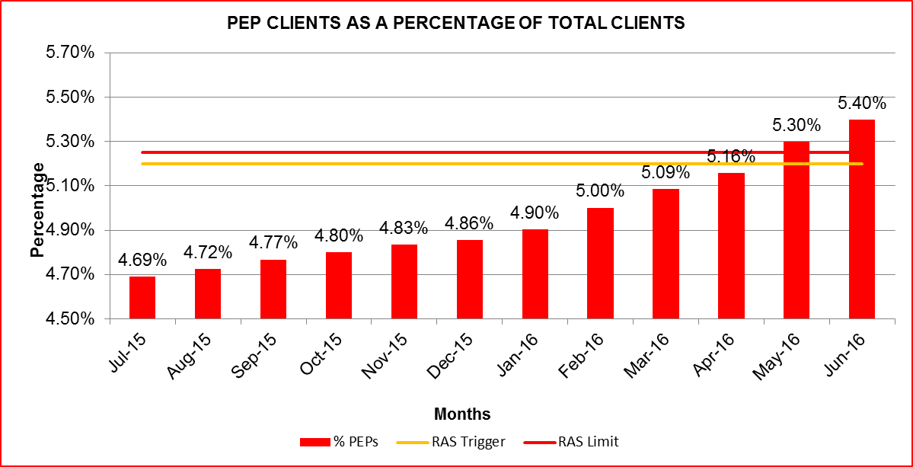
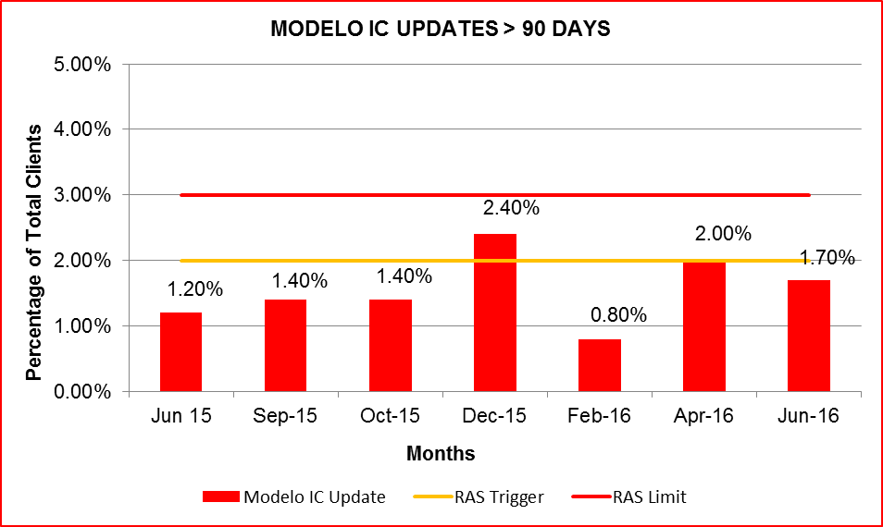
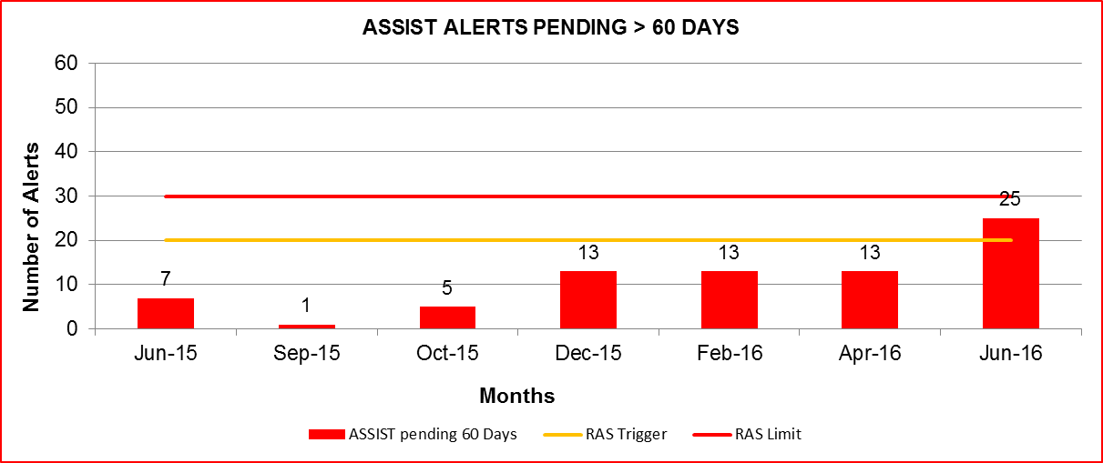
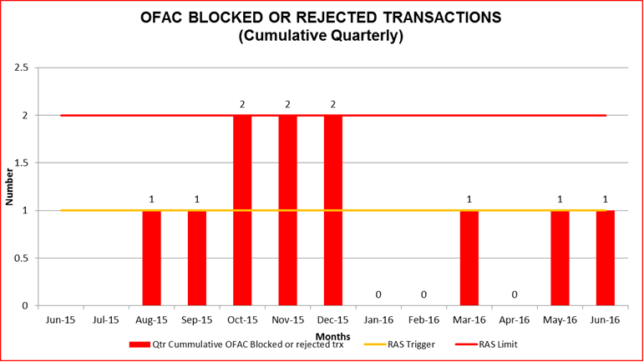
Compliance – AML Risk Appetite Metrics

Slide 46
Compliance – AML Risk Appetite Metrics
Relevant Deviations from Risk Appetite Statement - Escalation to Senior Management
High risk clients increased as the total number of clients decreased during the same period.
Percentage of PEP clients increased and exceeded RAS limit in June. During the months of May and June, a reclassification of current customers increased the number of total PEPs and at the same time, the total number of clients decreased. As a result, the percentage of PEPs to total clients increased. Initiated project to close PEPs with low balances to reduce risk and bring RAS below trigger.
ASSIST alerts pending greater than 60 days are above the RAS trigger due to resources devoted to the BSA/AML/OFAC Internal Audit as well as the FED Safety and Soundness examination during the quarter. Staff is addressing current clarifications, metric will be below trigger by month end.
All Account Officers with Modelos IC/KYC Updates expired over 180 days have been contacted in order to address all cases. Currently reviewing the expiration date criteria in the system to address internal audit recommendation.
Rejected transaction in May given close similarity to OFAC entry.

Slide 47
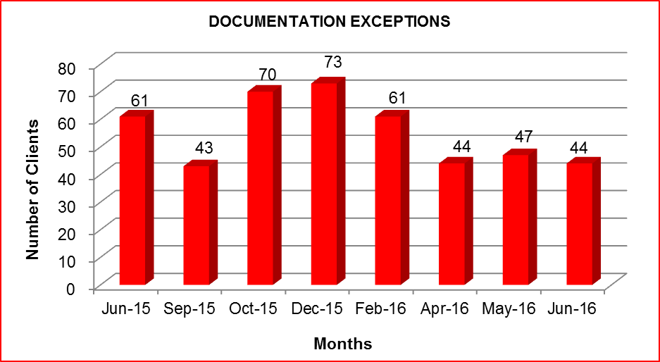
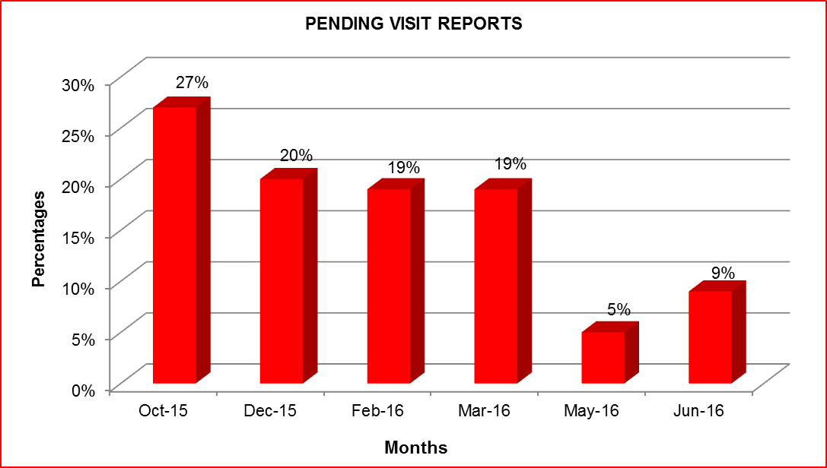
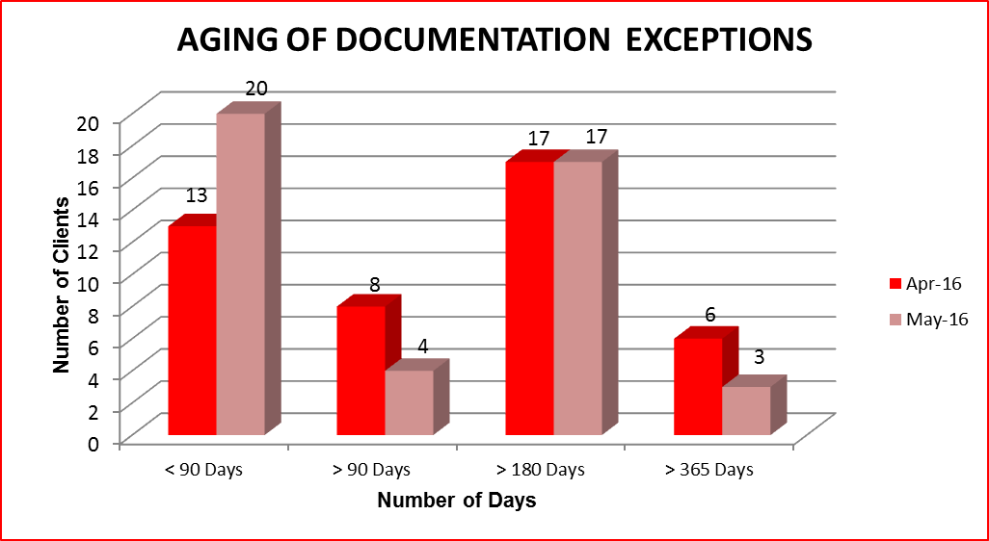
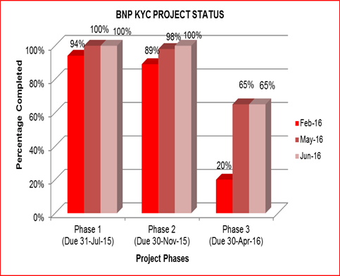
Compliance: AML Metrics
Relevant Compliance Items - Escalation to Senior Management
New client exceptions have remained stable in the period April – June 2016. Exceptions pending > 1 year have decreased to 3.
Aging of documentation exceptions now part of Zero Tolerance, impacting banker compensation.
Visit reports increased since May, but are still well below previous quarter figures. Pending Visit Reports are now part of Zero Tolerance.
BNP Project Phase 1 and Phase 2 are complete. Phase 3 is at 65% completion and stalled during May and June. Special follow up is being done with Front Office.

Slide 48
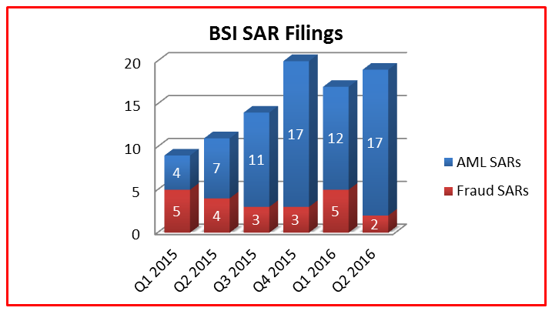
Compliance – Suspicious Activity Reports
Typology | Q2 2016 | Cumulative 2016 | 2015
BSA Money Laundering |  |  | 2
Check Structuring |  |  | 1
Fraud attempt | 2 | 7 | 15
IVTS | 8 | 11 | 18
Reputational | 8 | 16 | 11
Structuring |  |  | 1
Tax Evasion | 1 | 1
Terrorist Financing |  |  | 1
Unwilling to provide information |  | 1 | 4
Velocity/ML |  |  | 1
 | 19 | 36 | 54
Relevant SAR Related Items
Ref # 12/16 BSI was contacted by Homeland Security as a result of a personal check in the amount of US$ 500,000.00 sent via DHL to the bank for deposit without being properly reported. The check was confiscated by U.S. Customs and Border Protection. The bank conducted a review and learned that the personal check was issued by a BSI client and payable to a second BSI client. In the course of it's due diligence, BSI requested corroborating information and documentation from both customers to substantiate the transaction behind the issuance of the personal check. The clients failed to provide sufficient information or documentation supporting the transaction. A SAR was filed given the lack of transparency and the method by which the transaction was conducted.
Ref # 26/16: Extensive negative media involving the client’s activities in the mining industry and the client’s urgency to close his company and transfer funds to another jurisdiction due to the Panama Papers leak, prompted the filing of a SAR.
Ref # 28/16: The Panama Papers review identified allegations of a money laundering and corruption scheme with the government of Venezuela and Ecuador. Open source information also indicated the client’s related companies were involved in the corruption scheme.
 | Q2 2016 | Cumulative 2016 | 2015
Client Closing
Number of clients affected | 17 | 26 | 47
Number of clients closed | 6 | 10 | 35
% of clients closed | 35% | 38% | 74%

Slide 49
Compliance - AML Action Plan

Slide 50
Project Status
Panama Papers - Phase I Update
Scope of Review
Perform a detailed review of 158 clients that were identified as having exposure to Mossack & Fonseca either by having M&F as registered agent for their PICs, as directors or signers in their PICs or clients who sent wire transfers to M&F in the past 12 months. Focus on completeness of KYC information and documentation and source of wealth.
KYC Review
Assess quality of the KYC on file & annual updates Ensure source of wealth is well documented. Reconfirm accurate identification of beneficial ownership. Confirm beneficial ownership is correctly included in the Globus core system. Perform internet and negative media searches on all parties to the account. Search available public records in each jurisdiction, where available, to confirm current corporate status and registration.
Transactional Review
Generate activity totals for the last 5 years. Review accounts with AML alerts generated in last 5 years. Review last 5 years of transactions for clients that did not generate alerts to identify unusual activity. Perform negative media/internet searches on recurring originators and beneficiaries. Review accounts with investigations or SARs in the last 8 years.
Status of review as of 7-08-16
Performed KYC and transactional review for 158 clients (100%) with total AUMs of $399 million. 133 clients out of the 158 have been concluded with no findings to report. For 25 clients, additional information or documentation requests were made and are currently pending. A total of 6 material cases have been identified, analyzed and escalated to the SHUSA AML team. Analysis of the total client data base (158) was completed on May 27, in accordance with the target completion date.

Slide 51
Project Status
Panama Papers – Phase II Update
Phase II ICIJ List - status as of: July 8th, 2016
Status of review as of 7-08-16
Performed fuzzy logic searches of BSI’s client database against the International Consortium of Investigative Journalists (ICIJ) lists. (≈700k names). 20 additional confirmed matches resulted using 100% probability. The 20 clients have been reviewed using the same methodology as Phase I: 6 completed with no further action required. 14 additional documentation or information requests. No material cases identified so far. An additional review using match probability of at least 95% is being performed.

Slide 52
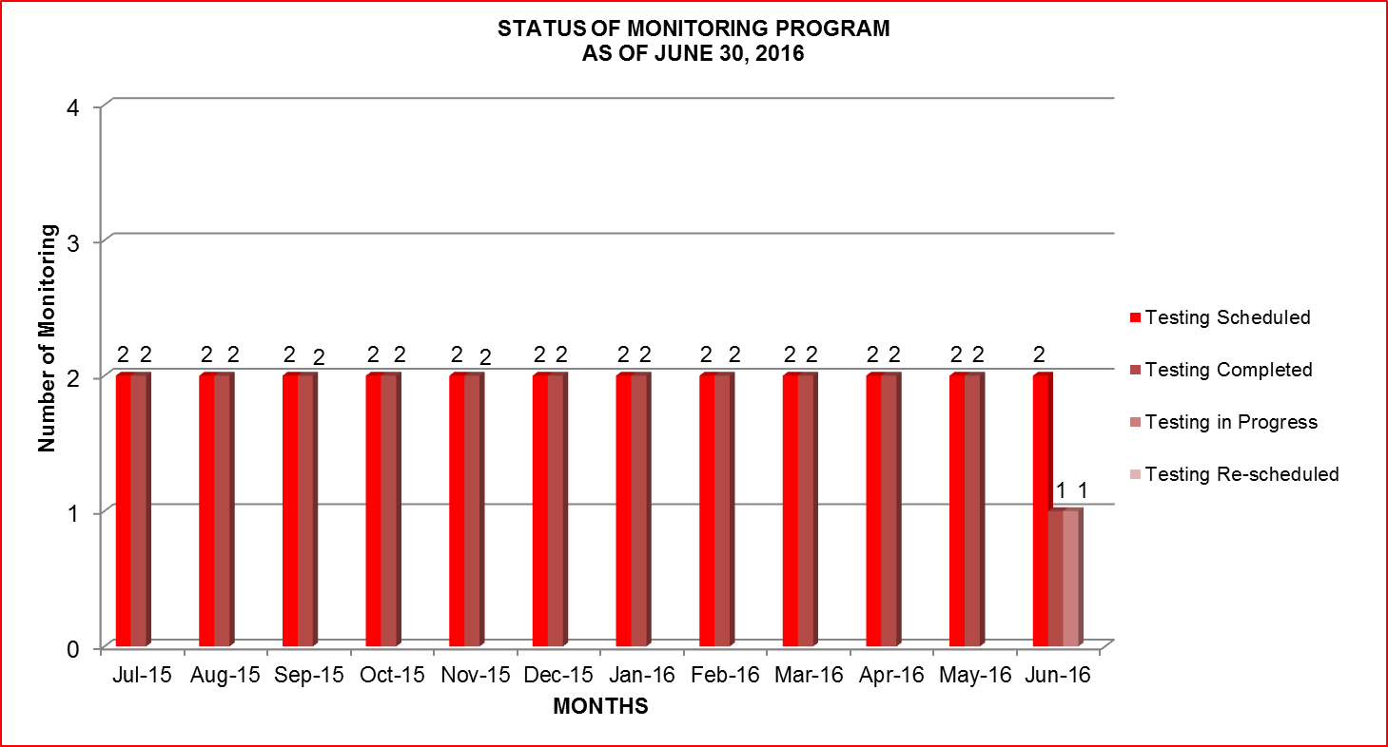
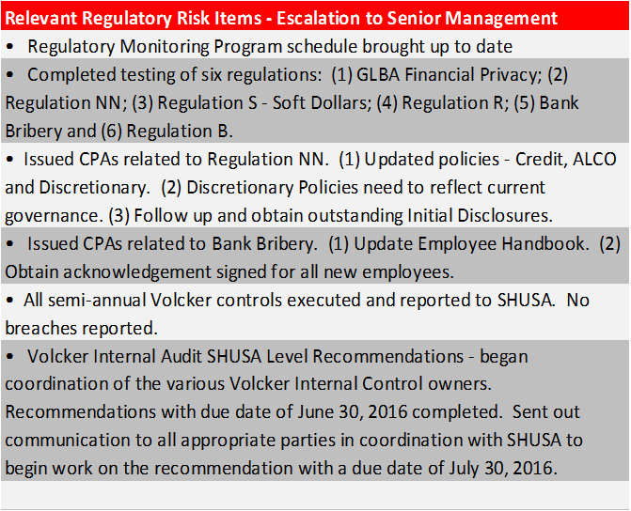
Regulatory Compliance

Slide 53
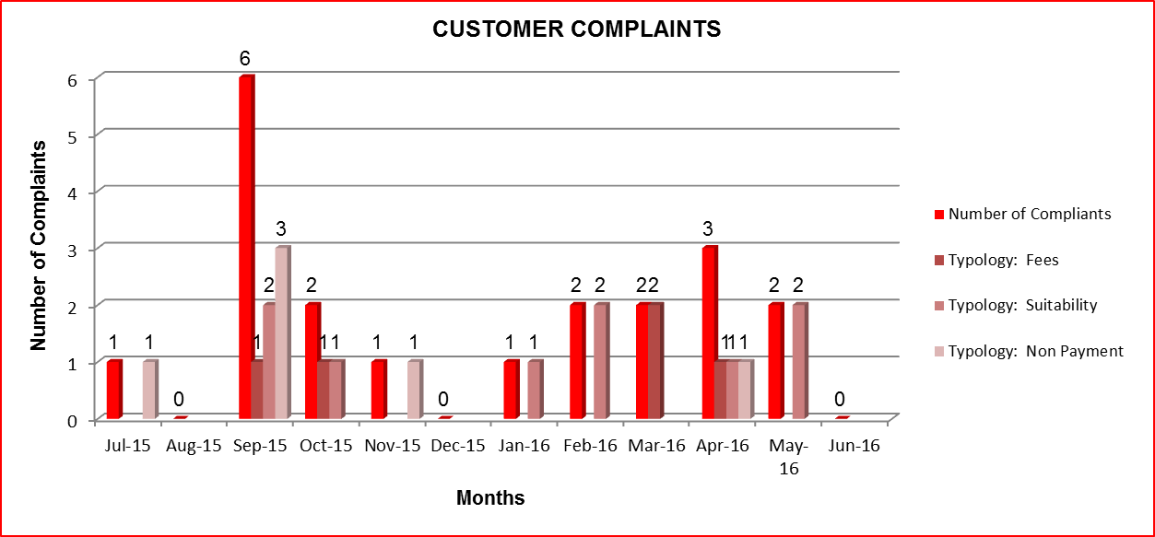
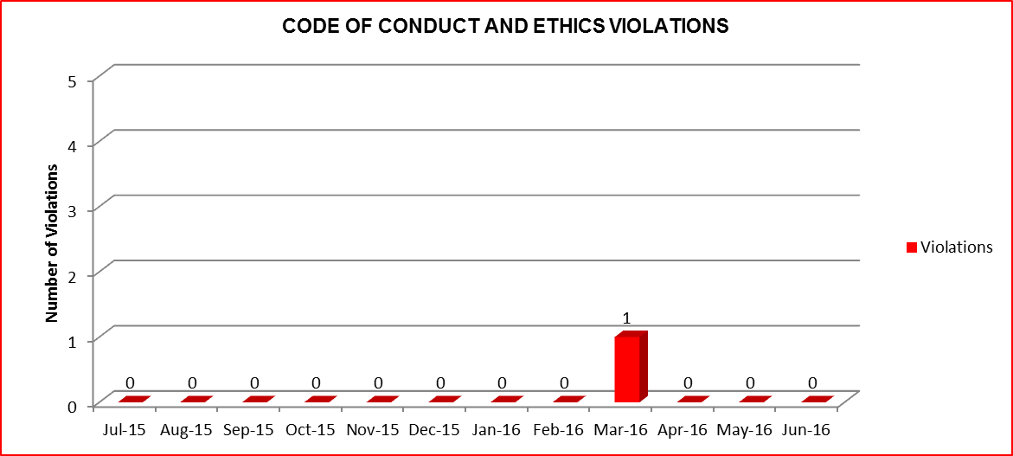
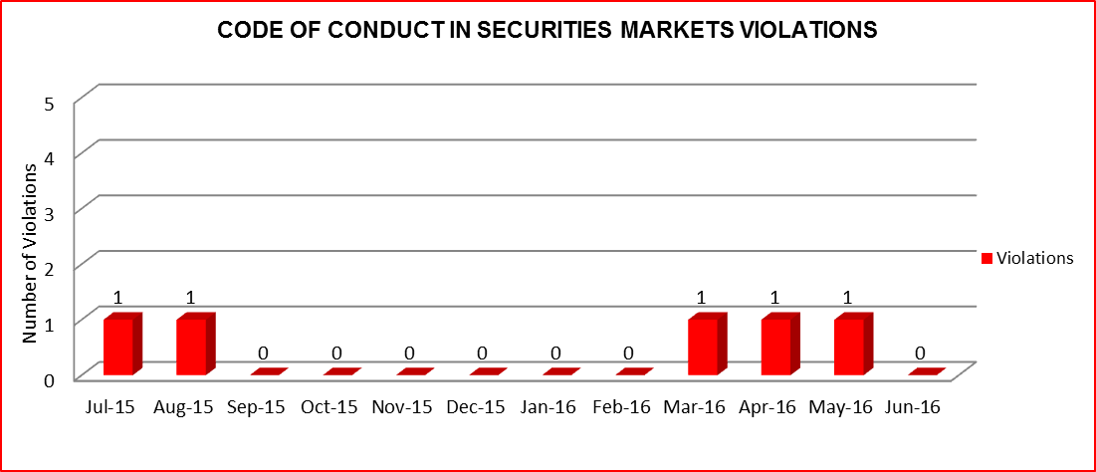
Compliance - Indicators
Customer Complaints:
One March complaint closed in April in favor of the Bank
Four (4) complaints were closed during May:
One February complaint closed in favor of the client. No need to liquidate the Euros to transfer funds. Reimbursed client approximately $85,00.
Three (3) complaints were closed during May; all in favor of the bank
No complaints closed during June 2016
Code of Conduct and Ethics Violations:
No violations for the months of April, May and June 2016
No repeat offenders
Code of Conduct in Securities Markets:
2 violations during the period April 1, 2016 through May 31, 2016
No violations for the month of June 2016
Face-to-face training provided
No repeat offenders

Slide 54
Agenda
0
Last Meeting Minutes
1
Executive Summary, Highlights & Risk Appetite Statement Update
2
Credit Risk
3
Financial Risk
4
Fiduciary Risk
5
Operational Risk
6
Compliance Risk
7
Policies and Procedures
8
Model Risk Management

Slide 55
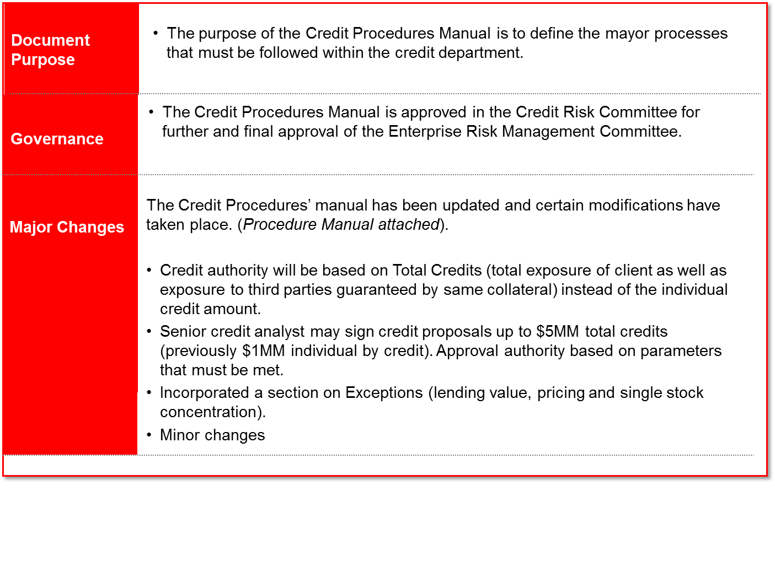
Credit Risk Procedure

Slide 56
Signing Authorities
Signing authority- Figures for the month of May 2016
Signing authority guideline
As of February 2016, signing authorities for credit proposals are guided by the Total Credit amount instead of the individual credit as previously. As a result, senior credit analysts’ signing authority has been diminished.
Request to modify the signing authority of the credit risks’ senior analysts from credit amount $1MM to total credits of $5MM.

Slide 57
Operational Risk Event Escalation (OREE) Procedure
Banco Santander International (“BSI”) Operational Risk Event Escalation (OREE) Procedure provides the steps to ensure:
Effective operational risk event escalation and monitoring. This is critical to proper mitigation and resolution of material and significant events.
Comprehensive entity wide approach.
Constant approach regardless of impact that leads to defensible decisions.
Clear communication, escalation, and accountability.
Key Concepts:
All OREs with impact are entered into the database.
Department Managers approve data “completeness” monthly.
ORE Investigations.
Control effectiveness measures.
Remediation plans require committee approval based on impacts.
Control testing is required to close an ORE.

Slide 58
Agenda
0
Last Meeting Minutes
1
Executive Summary, Highlights & Risk Appetite Statement Update
2
Credit Risk
3
Financial Risk
4
Fiduciary Risk
5
Operational Risk
6
Compliance Risk
7
Policies and Procedures
8
Model Risk Management

Slide 59
Model Risk Management Status
The four models that were reclassified as Expert Judgment Models (EJM) by MRMG are scheduled for validation 8/31/16:
552 - BSI Assist SuperScore - Miami
554 - OFAC Verifier – Miami
555 - BSI Client Suitability (360 HPB) – Miami
655 – ALLL Miami
Model Approval package will be presented in next ERMC.

Slide 60
Agenda
0
Last Meeting Minutes
1
Executive Summary, Highlights & Risk Appetite Statement Update
2
Credit Risk
3
Financial Risk
4
Fiduciary Risk
5
Operational Risk
6
Compliance Risk
7
Policies and Procedures
8
Audit Updates

Slide 61
Internal Audit – Recommendation Status
54% (14) recommendations of all Internal Audits are fully implemented.
46% (08) recommendations are unexpired and not implemented.
 | As of June 30, 2016
 | SUMMARY
 | Rating | Total | Fully Implemented | Past Due |  | Unexpired Recommendations
 |  |  |  | Partially Implemented | Not Implemented | Partially Implemented | Not Implemented
BSI - FINANCIAL STATEMENTS 2015 | B | 3 | 3
BSI - BRANCHES AUDIT 2015 | No Rating | 1 | 1
BSI - IT APPLICATION AUDIT 2015 | Satisfactory | 1 | 1
BSI - IT GOVERNANCE, PLANNING AND MANAGEMENT 2015 | Satisfactory | 3 | 3
BSI - BUSINESS CONTINUITY PLAN 2015 | Satisfactory | 1 |  | 1
BSI - IT SECURITY 2015 | Needs Improvement | 5 | 5
BSI - FIDUCIARY PRINCIPLES AND STANDARDS 2016 | Satisfactory | 4 | 1 |  |  |  | 3
SHUSA - VOLCKER RULE AUDIT 2016 | Satisfactory | 4 |  |  |  |  | 4
BSI - BSA/AML/ AUDIT 2016 | Needs Improvement | 4 |  |  |  |  | 4
TOTAL |  | 26 | 14 | 1 | 0 | 0 | 11
% of Total |  | 100% | 54% | 4% | 0% | 0% | 42%

Slide 62
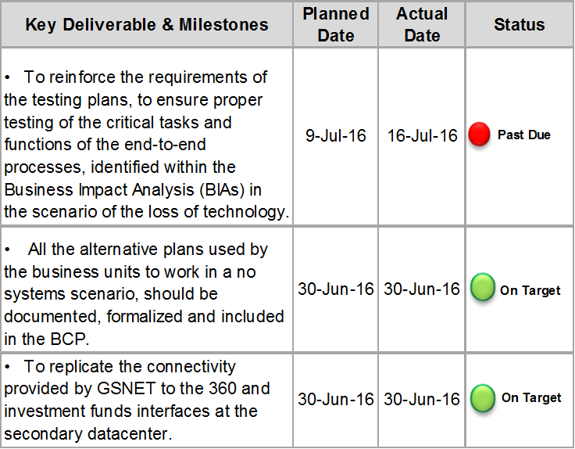
Internal Audit – Past Due Item

Slide 63
Appendix

Slide 64
Stale Price – Top 25

Slide 65
Stale Price Report
The following is the “Stale Price” control by categories totaling 57 securities (41 reported in May) with an exposure of USD 10.56 MM (USD 27.19 in last committee).
None of them has LV

Slide 66
Compliance – Summary of SARs
SUMMARY OF SARs FOR THE PERIOD APRIL 1, 2016 THROUGH JUNE 30, 2016
# |  | Date of Report |  | Financial Loss |  | Relation to BSI |  | Reason |  | Description of Suspicious Activity |  | Action Taken
10/16 |  | 4/1/2016 |  | No |  | Client |  | IVTS |  | The customer received eight wire transfers totaling US$ 396,580 (each for ≈ US$ 50k). The customer explained that the wires were due to the currency limit of US$ 50k in China for each transaction and that the payments were sent by friends and relatives to purposely avoid the currency quota. BSI filed a SAR as a result of the client’s structuring of wire transfer payments to circumvent requirements in China. |  | In process of De-marketing
11/16 |  | 4/1/2016 |  | No |  | Client |  | IVTS |  | Client sent funds for four months totaling US$ 400K to an unknown beneficiary. When questioned the client was unable to provide information justifying the transactions received in his account. As a result, a SAR was filed for potentially conducting transactions in the informal value transfer system, commonly known as IVTS. |  | De-marketed
12/16 |  | 4/15/2016 |  | No |  | Client |  | IVTS |  | BSI was contacted by Homeland Security as a result of a personal check in the amount of US$ 500,000.00 sent via DHL to the bank for deposit without being properly reported. The check was confiscated by U.S. Customs and Border Protection. The bank conducted a review and learned that the personal check was issued by a BSI client and payable to a second BSI client. In the course of it's due diligence, BSI requested corroborating information and documentation from both customers to substantiate the transaction behind the issuance of the personal check. The clients failed to provide sufficient information or documentation supporting the transaction. A SAR was filed given the lack of transparency and the method by which the transaction was conducted. |  | One client has been De-marketed; the other is in process
14/16 |  | 5/17/2016 |  | No |  | Non-Client |  | Fraud attempt |  | Bank received an email attempting to defraud client of US$ 90K. After receiving the wire transfer instructions, the bank proceeded to conduct its security call back procedure and contact the customer to confirm the instructions. The customer informed they had not submitted the wire transfer instructions. As a result, the payment was not processed and a SAR was filed due to the attempt by an unknown suspect to commit the crimes of identity theft and wire transfer fraud. |  | Accounts have been blocked internally
15/16 |  | 5/5/2016 |  | No |  | Client |  | Negative Media |  | The bank identified negative media articles alleging foreign corruption & money laundering. The clients, both attorneys and owners of a law firm in Brazil are accused of bribing a judge to favor a verdict for a client of their firm. The transactions in the account did not appear to relate to the allegations, however in light of the allegations a SAR was filed. |  | In process of De-marketing
16/16 |  | 4/29/2016 |  | No |  | Non-Client |  | Negative Media |  | BSI filed a SAR as a result of negative open source information on non-BSI clients. Nestor Marcelo Ramos, Helvetic Services Group SA, and Lazaro Baez. The Article alleges that Helvetic Services Group SA was the company used by Lazaro Baez, an associate of Nestor and Cristina Kirchner, the former presidents of Argentina, to steal money from Argentina. The SAR listed ten clients that were indirectly involved due to the utilization of the same registered agent (Marcelo Ramos) and the negative media articles. |  | N/A
17/16 |  | 4/21/2016 |  | No |  | Client |  | IVTS |  | BSI identified one hundred-eleven incoming ACH transactions totaling US$ 83,950 from account opening to present received from a Federal Credit Union in Washington DC that did not appear to be in line with the transactions the customer would normally be expected to engage. The customer informed the bank that the ACH transactions were from US$ currency exchanges with a friend in Venezuela. As a result, BSI filed a SAR on the customer for engaging in transactions involving the unofficial exchange of US Dollars for the local currency in Venezuela, also known as the Informal Value Transfer System ("IVTS"). |  | De-marketed

Slide 67
Compliance – Summary of SARs
# |  | Date of Report |  | Financial Loss |  | Relation to BSI |  | Reason |  | Description of Suspicious Activity |  | Action Taken
18/16 |  | 4/29/2016 |  | No |  | Client |  | IVTS |  | BSI filed a SAR supplementing a previously submitted SAR on April 15, 2016, in connection with a seizure order received from the department of Homeland Security. During its ongoing review of the entire relationship, BSI reported a total of US$ 10,140,609 in activity that did not seem to have any apparent economic, business or lawful purpose and appears to have been conducted in a manner that is consistent with the informal value transfer system (IVTS). |  | De-marketed
19/16 |  | 5/4/2016 |  | No |  | Client |  | Negative Media |  | BSI identified an online negative media article dated March 28, 2016 alleging a potential foreign corruption scheme that may have included the payment of bribes to foreign officials in the Republic of Panama. According to the article the customer through his accounts at Citibank and Banco Universal allegedly made payments to the former vice president of Panama after the Customer was awarded the contract for a construction project in Panama. In light of the alleged accusations, a SAR was filed. The bank will continue its due diligence to identify any additional possible suspicious activity and will file additional SARs as deemed necessary. |  | Watch List
20/16 |  | 5/12/2016 |  | No |  | Client |  | Negative Media |  | BSI identified online negative media articles alleging the company owned by the client in Guatemala was found guilty of tax evasion. The articles allege that the company owed approximately US$ 35MM in taxes and that the local company paid bribes to members of the Guatemalan tax authority in order to facilitate its tax evasion. None of the alleged transactions were conducted through BSI, however a SAR was filed due to the negative media. |  | In process of De-marketing
21/16 |  | 5/19/2016 |  | No |  | Client |  | Negative Media |  | BSI identified recent open source media articles alleging that during the period of 2009 through 2013, an alleged front company was used to launder money in Brazil. The article indicates a total of US$ 1,065,514.76 was sent to a brokerage company where the BSI client is the majority shareholder. BSI reviewed the accounts' activity from May 17, 2013 until May 18, 2016 totaling one hundred and ten transactions, with a total of US$ 20,200,672.63, however the transactions in the customers' accounts do not appear to relate to the allegations in the negative media. In light of the allegations against the client's brokerage firm, BSI filed a SAR. |  | Watch List
22/16 |  | 6/14/2016 |  | No |  | Non-Client |  | Fraud Attempt |  | BSI received an email attempting to defraud client of US$ 250K. After receiving the wire transfer instructions, the bank proceeded to conduct its security call back procedure and contacted the customer to confirm the instructions. The customer informed the bank that they had not submitted the wire transfer instructions. As a result, the payment was not processed. The bank deems this event suspicious as the wire transfer instructions received was an attempt by an unknown suspect to commit the crimes of identity theft and wire transfer fraud. |  | N/A
23/16 |  | 5/31/2016 |  | No |  | Client |  | IVTS |  | During the course of bank's review of activity in the accounts for the period of March 18, 2016 to May 5, 2016, the bank identified twelve outgoing wire transfers totaling US$ 642,456.30 that did not seem to have any apparent economic, business or lawful purpose. The customer failed to produce sufficient information or documentation supporting the funds transfers. As a result, the bank suspects Customer may have engaged in transactions through the informal value transfer system (IVTS) and filed a SAR accordingly. |  | In process of De-marketing
24/16 |  | 5/31/2016 |  | No |  | Client |  | Taxes |  | BSI received communication from a Brazilian law firm representing the client in relation to the regularization of client's financial resources abroad. The documents refer to the Brazilian law that allows individuals or legal entities, residing or domiciled in Brazil to voluntarily declare legally obtained goods or titles that were previously undeclared. BSI filed this SAR given the fact the client 's funds at BSI appeared to be undeclared to the Brazilian tax authorities. |  | In process of De-marketing
25/16 |  | 6/3/2016 |  | No |  | Client |  | IVTS |  | BSI identified twenty-six incoming transactions totaling US$ 3,384,109.01 and twenty-one outgoing transactions totaling US$ 4,694,137.00 that appeared to be inconsistent with the client's normal activity and stated purpose of the account. The client failed to produce information or documentation supporting the transactions. As a result of client's failure to produce documentation, the bank filed a SAR for conducting transactions in what appeared to be the informal value transfer system (IVTS). |  | De-marketed

Slide 68
Compliance – Summary of SARs
# |  | Date of Report |  | Financial Loss |  | Relation to BSI |  | Reason |  | Description of Suspicious Activity |  | Action Taken
26/16 |  | 5/27/2016 |  | No |  | Client |  | Negative Media |  | A SAR was filed due to the client's request to transfer his assets to a different jurisdiction due to the Panama Papers leak as the request could be viewed as an apparent attempt to conceal the true ownership of the accounts. The SAR was also filed due to the extensive negative media alleging links to illegal mining operations. |  | De-marketed
27/16 |  | 6/3/2016 |  | No |  | Client |  | IVTS |  | BSI filed a second SAR on the client for an ongoing ACH transaction conducted in the informal value transfer system (IVTS) by a client reported in April 2016. In its ongoing review the client received one ACH transaction for US$ 1,200 as a result of an informal currency exchange in Venezuela. |  | De-marketed
28/16 |  | 6/17/2016 |  | No |  | Client |  | Negative Media |  | BSI identified negative media articles alleging the client through his bank was involved in a money laundering and corruption scheme with the governments of Venezuela and Ecuador. The open source information also indicated the client’s related companies were also involved in the corruption scheme. As a result of these findings, BSI proceeded to file a SAR. |  | In process of De-marketing
31/16 |  | 6/27/2016 |  | No |  | Client |  | Negative Media |  | According to open source media articles, an investigation by the government of Guatemala found that the client, together with several prominent businessmen from Guatemala, donated large sums of money to political party candidates during the 2011 Guatemalan general elections. Allegedly, in return for their donations, the client and the other donors would receive exclusive government contracts. The client's companies, according to the investigation, received an equivalent of US$ 100MM in contracts between 2005 and 2016. The companies allegedly received millions worth of government contracts during the Presidency of Otto Perez Molina, who has since been impeached. Recently, both ex-president Perez Molina and ex-vice-president Roxana Baldetti were placed in jail on allegations of corruption and money laundering. The individuals allegedly involved in this scandal including the client, are being accused of money laundering, illicit association, and bribery. The article further states that Guatemalan authorities have alerted Interpol. During the period ranging between March 20, 2012 and June 15, 2016 the client had two incoming wires totaling US $2,044,104.04 in April 2012 from a personal account at Standard Chartered and a check payment totaling $120.00. No further activity occurred during the review Period; however, in light of the negative open source media alleging the client's involvement in a foreign corruption scandal, related to the former President and Vice-President of Guatemala, the Bank files this SAR. |  | Watch List

Slide 69
Internal Audit – Fiduciary Principles and Standards Audit

Slide 70
Internal Audit – Fiduciary Principles and Standards Audit

Slide 71
Internal Audit – Volcker Rule Program for Santander US Audit

Slide 72
Internal Audit – Volcker Rule Program for Santander US Audit

Slide 73
Internal Audit – Volcker Rule Program for Santander US Audit

Slide 74
Internal Audit – Volcker Rule Program for Santander US Audit

Slide 75
Internal Audit – Volcker Rule Program for Santander US Audit

Slide 76
Internal Audit – Volcker Rule Program for Santander US Audit

Slide 77
Internal Audit – Volcker Rule Program for Santander US Audit

Slide 78
Internal Audit – Volcker Rule Program for Santander US Audit

Slide 79
Internal Audit – Anti-Money Laundering System
BANCO SANTANDER INTERNATIONAL
ACTION PLAN AS OF JUNE 30, 2016
REPORT OF ANTI-MONEY LAUNDERING SYSTEM
REPORT OF EXAMINATION DATE JUNE 2016
# | RECOMMENDATIONS | TIME TABLE | RESPONSIBILITY | MANAGEMENT’S RESPONSE | STATUS
1 | For the client's AML risk rating at account opening, define, document and request AML/FT Corporate Area's approval, for a weighted AML risk rating matrix with specific weights for all the relevant factors required by internal and external regulators. Once approved, apply the new risk rating to the entire client database. | 31-Jan-17 | P. Prado | BSI is in the process of programming the account opening risk matrix to enhance the calculation of the ultimate risk score for the clients, including a weighted risk rating matrix for all of the components. | In Process
2 | 2. In regards the update of the information of the customer 2.1 For the Modelo IC updates, management should modify the calculation in the 360 tool of the expired Modelo ICs in order to calculate the date from the original update performed by the Account Officers and not from the Compliance approval and correct the expiration date of the Modelo ICs to reflect the original date of which it was performed by the Account Officer. 2.2 Identify in the system when the Modelo IC has been reviewed and presented by compliance in order to evidence the audit trail of the approval process. | 30-Nov-16 | P. Prado | BSI is reprogramming the 360 tool with the change in the expiration date calculation for the online KYC updates. The tool is also being enhanced to provide an audit trail of all stages of the online KYC completion process. | In Process
3 | Regarding the cross checks against lists, implement a data quality governance framework and review process to validate that the screening process is working correctly. | 30-Nov-16 | P. Prado | BSI has included in its BSA/AML procedures a requirement for all Compliance related technical issues to be escalated to the Compliance Committee. Additionally, BSI has incorporated in the Compliance Committee agenda a Technical Issues section. | In Process

Slide 80
Internal Audit – Anti-Money Laundering System
# | RECOMMENDATIONS | TIME TABLE | RESPONSIBILITY | MANAGEMENT’S RESPONSE | STATUS
4 | Enhance the monthly Qualitative Review of Assets Exceptions by establishing a selection sample criteria in terms of risk, reinforce training of the analysts document the procedures of the exceptions dispositions analysis in order to homogenize the process and, when necessary, increase the sample size the order to prevent alerts without supporting documentation. | 30-Nov-16 | P. Prado | BSI is currently reviewing its qualitative review process in order to incorporate the recommended enhancements. | In Process
 | Total | Implemented | Past Due |  | Unexpired Recommendations
 |  |  | Partially Implem. | Not Implem. | Partially Implem. | Pending
Recommendations | 4 | 0 | 0 | 0 | 0 | 4
 | 100% | 0% | 0% | 0% | 0% | 100%

Slide 81
Incident Management Framework
Incident Management Team
Incident has significantly impacted life safety, asset protection, business operations, reputation or communities.
Response Teams require additional support / decision making authority or impact extends to multiple departments / products.
After Action Reviews
(ORE DB)
Close
Incident Management Team
Incident Management Plan
Escalate
Crisis Communications
Crisis Communications Plan
Incident Response Teams & ………
Incident’s impact evolves beyond the scope of daily operational tolerance.
Response teams activate to manage the Incident.
Close
Business Response
Disaster Recovery (IT)
Emergency Response
Security Response
*Pandemic Response
Operational Risk Event
Plans
Business Continuity Plan
Disaster Recovery Plan
Emergency Response Plan
Security Incident Response Plan
Health Incident Response Plan
ORE Escalation Procedure
Escalate
Daily Operational Disruptions
Incident that are managed as part of normal operations.
Actions plans and escalation paths within single departments.
Operational Risk Events.
Close
Notes:
*Pandemic Responses (Health Incident Response Plan) managed by IMT.

Slide 82
Incident Management – Roles and Responsibilities
Incident Management Team (IMT)
Executive Decision Maker
Alvaro Morales / Eloina Franco-Espinosa
Coordination & Support Emergency Procedures.
Incident Commander (BCP Officer)
Elizabeth Noda
Coordination & Support Emergency Procedures.
Crisis Management Director (Senior Management)
Rodolfo Bucaro
Senior manager appointed as “Crisis Management Director” (CMD). This CMD will assume responsibility for coordinating the actions of the functions and governance bodies involved when an Incident arises.
General Services
Clara de Castro / Leonard Gonzalez
Drives execution of Emergency Response Procedures; Provide facility status reports; Activate Hot Site.
Information Technology
Jesus
Systems & Telecommunications Recovery.
Comms Team
Human Resources
Martha Mancini / Pedro Gomez
Employee communications (i.e. Activate Phone Conference; Send mass notifications)
Marketing and Publications
Maria Gisbert
Client Communications and Customer Service.
IMT Support Group
Finance
Frances Vega
Emergency Cost Tracking.
Operational Risk
Marcos Galigarcia / Israel Vegas
Operational Risk Event Management, BC/DR Advisory.
Operations
Marco Prado
Business Recovery.
BSI Site Leads
Site specific recovery considerations, and feedback.
IMT Members (+ Support Group)
14

Slide 83
Operational Risk Events
Event Amount | Non Operational Loss | Gross Operational Loss | Recoveries | Event Summary | Mitigation | Posted Month | Ocurrance Date
$ (16,690.49) | - | $ - | $ - | Check was cashed twice. Bookkeeper approved payment without noticing the alert in the system | Employee was counseled | 06/2016 | 05/05/2016
$ (39.95) | - | $ (39.95) | - | Fraudulent charge on customer's debit card. | Issue debit card with chip technology expected by 09/30/2016 | 06/2016 | 01/06/2016
$ (780.00) | - | $ (780.00) | - | Advisor communicated to trader a different instruction than the one instructed from the client. | Client to communicate directly with AIS specialist assigned | 06/2016 | 02/19/2016
$ (32.96) | - | $ (32.96) | - | Wrong security was sold from the client's portfolio. | Employee was counseled | 06/2016 | 04/28/2016
$ (533.32) | $ (533.32) | - | - | Client's W8 was not updated and in consequence client was withheld at a higher rate. | Client was reimbursed. | 06/2016 | 12/31/2016
$ (284.35) | - | $ (284.35) | - | Advisor ordered to sell more than client held due to a manual error. | Advisor will review orders before transmitting to Traders. Advisors and traders will always pre-allocate orders in AIM prior to execution. | 06/2016 | 05/05/2016
ERMC

Slide 84
Operational Risk Events
Event Amount | Non Operational Loss | Gross Operational Loss | Recoveries | Event Summary | Mitigation | Posted Month | Ocurrance Date
$ (600.00) | - | - | - | Dormant activation was requested for the wrong customer, resulting in fees for original client | Employee was counseled | - | 01/03/2015
- | - | - | - | Line was not being recorded for an employee in San Diego. | Detected through Ops Risk testing controls. Extension was programmed to record by IT. | - | 04/07/2016
$ (128,629.10) | - | - | - | Overdrafts in Globus within a credit line only validate against limit availability, not collateral. | IT is working on a project to resolve this issue. | - | 06/10/2016
- | - | - | - | FX rates interface went down creating mispricing on rates | Issues with T-24 phantoms which runs the interface have been fixed | - | 06/15/2016
- | - | - | - | Core banking was unavailable for 32 minutes (P-3) due to the processing of a file containing a text that the system processed as a code. | Text was identified and modified Jbase was Startup | - | 07/01/2016
- | - | - | - | Assistant submitted a sell order as a buy order resulting in a gain for the client. | Employee was counseled | - | 05/10/2016
- | - | - | - | Broken pipe on the 11th floor was leaking over Bloomberg station | Stations were covered in plastic. Broken pipe was fixed | - | 06/10/2016
ERMC

Slide 85

2016 IRA Phase II - Roles and Responsibilities
Link to full report: https://app.bcinthecloud.com/prod3/m/main.jsp?act=clean&pageId=39407665&reportId=40389953

Slide 86

2016 IRA Phase II - Critical Process Report
Link to full report: https://app.bcinthecloud.com/prod3/m/main.jsp?act=clean&pageId=39407665&reportId=39878874

Slide 87
Thresholds for Escalation and Investigation
THRESHOLDS
Type of Impact | SHUSA Material Event (R1) | SHUSA Significant Event (R2) | BSI Escalation and Investigation
Economic / Financial | ≥USD$1M financial loss, or ≥USD$1M P&L impact/exposure Incidents with the same root cause whose aggregate amount in the last 12 months ≥USD$1M | >USD$100k - <USD$1M financial loss Incidents with the same root cause whose aggregate amount in the last 12 months >USD$100k | Financial loss, or P&L impact/exposure ≥ $50K Incidents with the same root cause whose aggregate amount over the last 12 months exceeds $100K
Regulation | Event information identified may lead to heightened regulatory scrutiny resulting in investigation and likely enforcement actions Event information identified represents violation(s) of law | Event information identified may lead to regulatory inquiry Event information identified with the potential to be cited as violation(s) of law | Deviation from regulatory best practice Potential lawsuit or judgment against the bank
Reputational and Media Impact | Extensive headline coverage of the event in the national media. Incident involving loss of proprietary/confidential information and/or strategies | Coverage of the event by local media (print, online, etc.) Incident that involves access by third parties to internal information of the bank | Event results in negative or unfavorable local media coverage

Slide 88
Thresholds for Escalation and Investigation (Cont’d)
THRESHOLDS
Type of Impact | SHUSA Material Event (R1) | SHUSA Significant Event (R2) | BSI Escalation and Investigation
Clients and Service | Technological incidents classified as P1 or P0 Affecting more than 1% of the clients, or 50,000 in absolute value, causing them some kind of harm Security incidents which have involved loss of confidential customer information | Technological incidents classified as P3+ or P2 Affecting more than 0.1% of the clients, or 1,000 in absolute value, causing them | P0, P1, P2, P3+ or P3 Affecting >= 10 clients Loss of or exposure to confidential or restricted information or internal information
Other | N/A | N/A | Internal and External Fraud (except cards) Employment practices or workplace safety Loss of use of facility Risk Indicator turns yellow or red Client complaints resolved in favour of the client Code of conduct violations

